Slide 1
Voeding en mondgezondheid (en relaties met chronische welvaartsziekten).
Jaap Seidell Vrije Universiteit Amsterdam

Slide 2
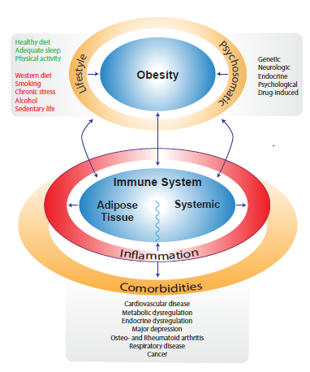

Slide 3
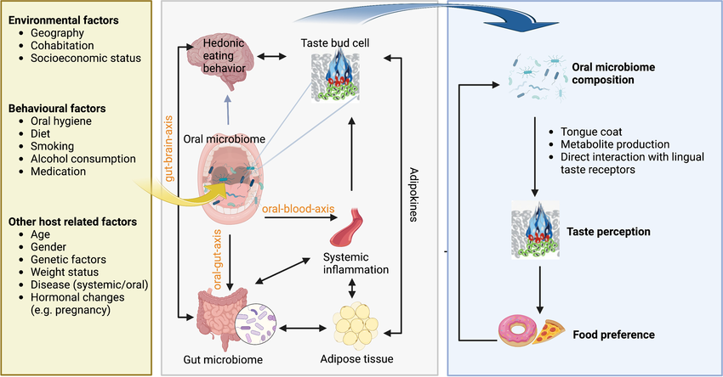

Slide 4
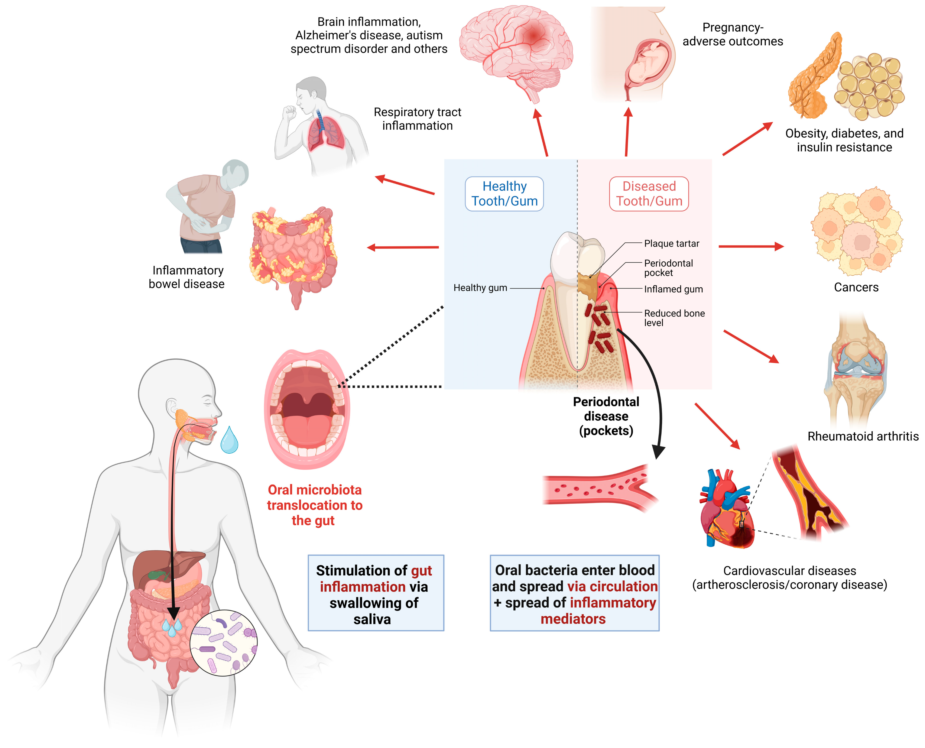

Slide 5
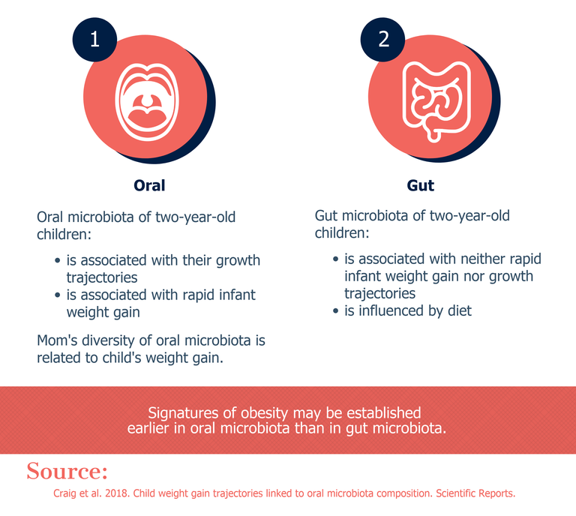

Slide 6
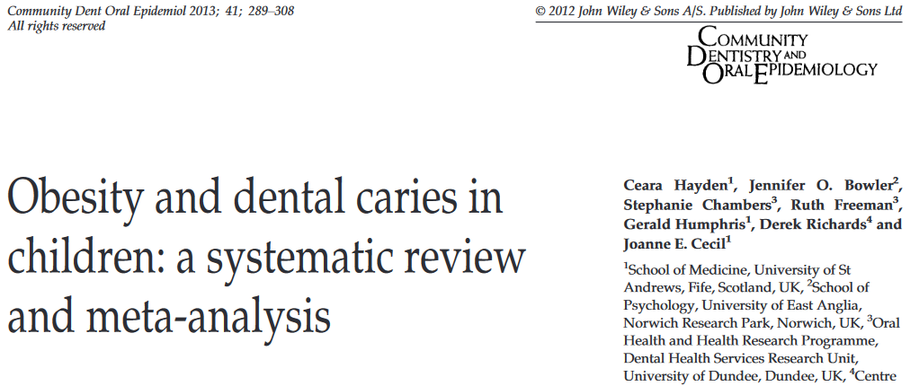

Slide 7
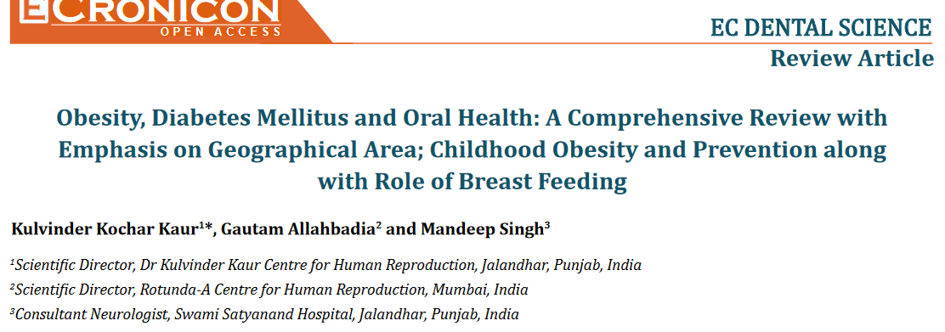

Slide 8
Kaur et al
in this study special emphasis was given on the correlation of obesity and poor health in different geographical areas, effects on childhood obesity and dental health, role of breast feeding and importance of prevention of poor oral health, oral hygiene habits and how it could be tracked right from pregnancy to infancy to childhood to old age.
Prevention remains the mainstay of avoiding it with avoidance of sweets, daily brushing twice and repeated dental visits, in the presence of obesity and T2DM were associated with double the incidence of periodontal diseases as compared to the presence of obesity and T2DM alone

Slide 9
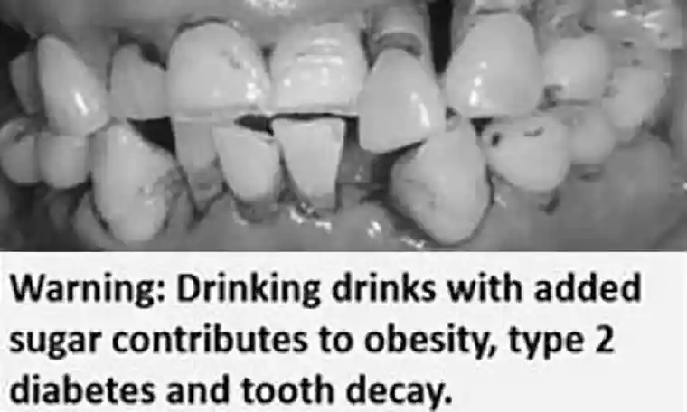
Sugary drinks start in infancy

Slide 10
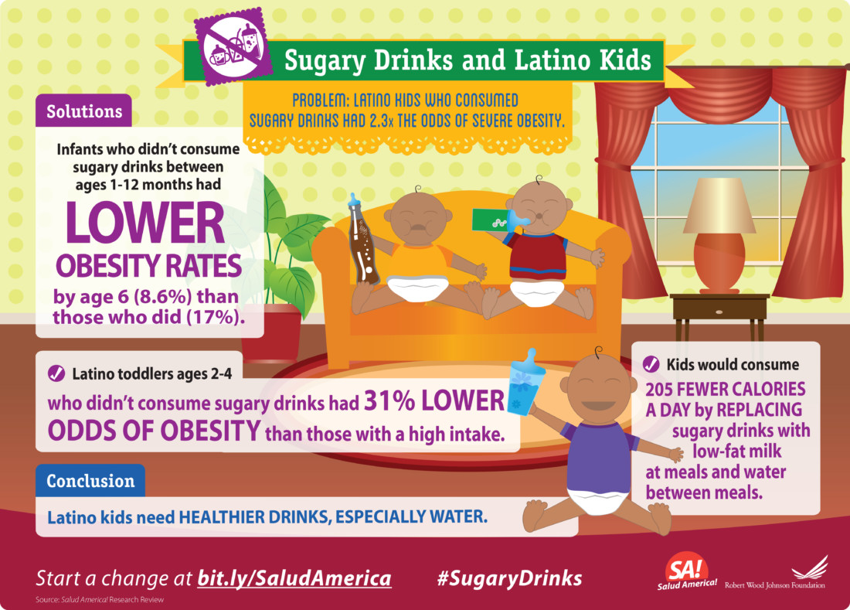

Slide 11
Conclusions
The first 1000 days are a critical period for future health
In the first 2 lifeyears the foundation for poor physical, mental and oral health is established
Sugary drinks and ultra-processed foods seem the main link.
Mechanisms include acidity and sugar in products but also microbiota and chronic low grade inflammation may play a role.
Emphasis on early life for the prevention of obesity and dental health is essential

Slide 12
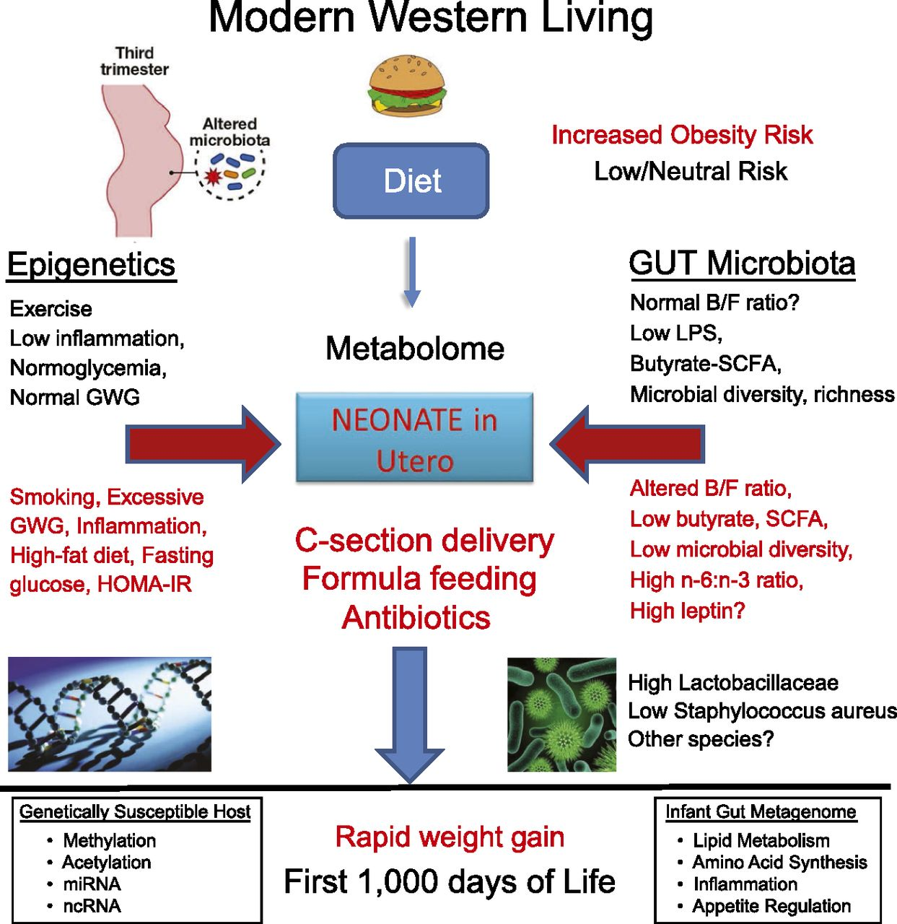

Slide 13
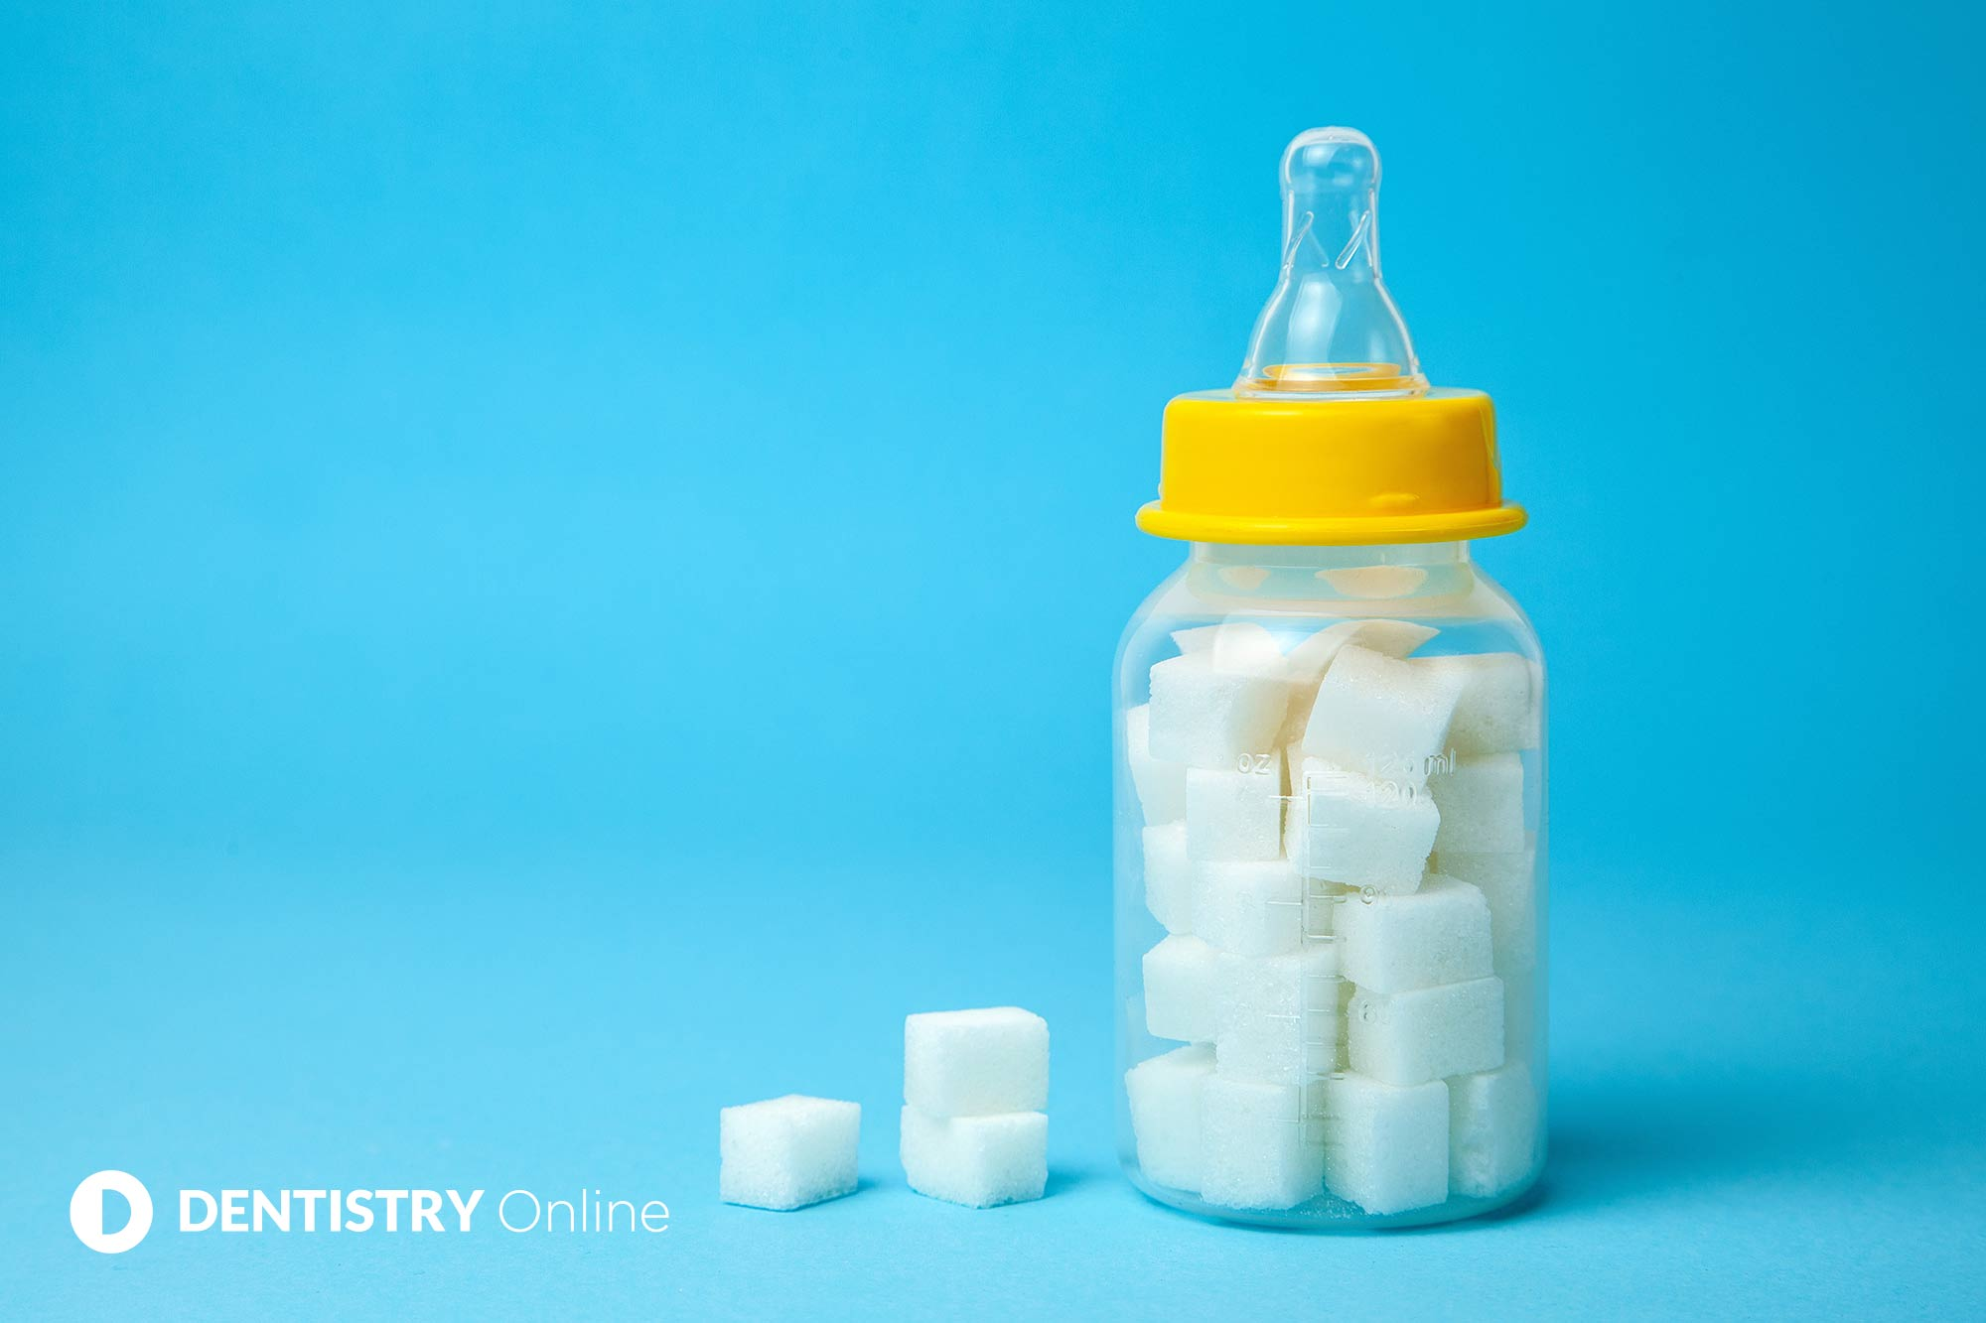

Slide 14
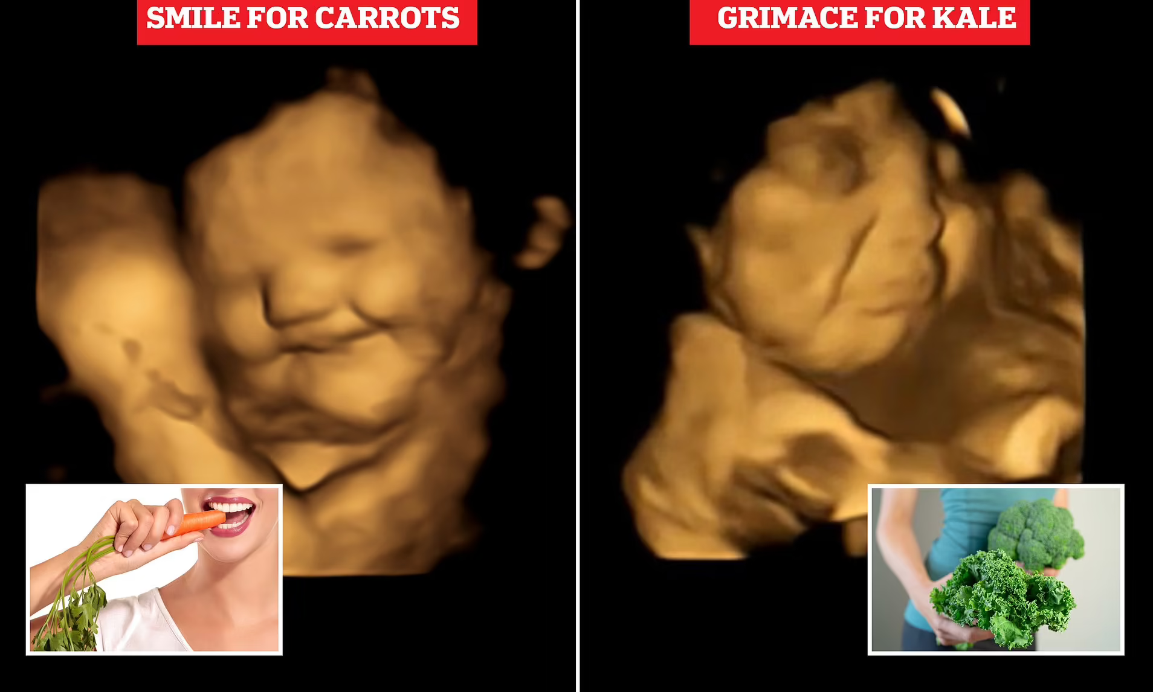

Slide 16
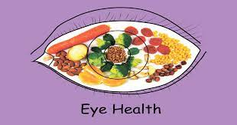

Slide 17
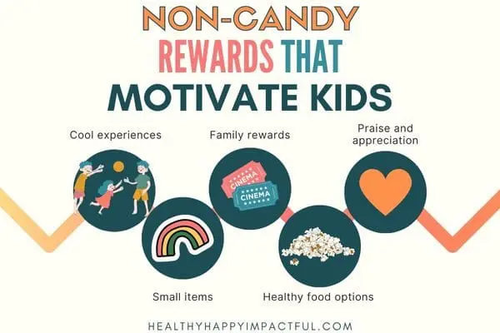

Slide 18
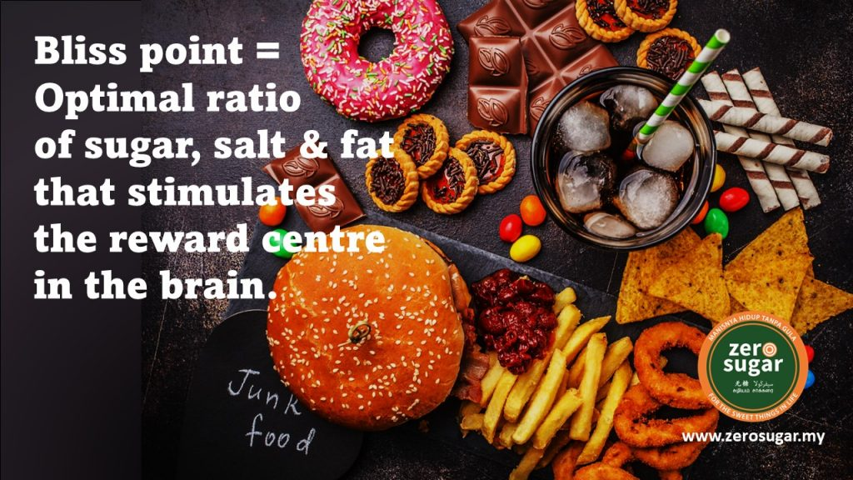
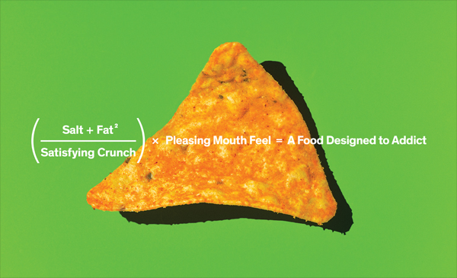

Slide 21
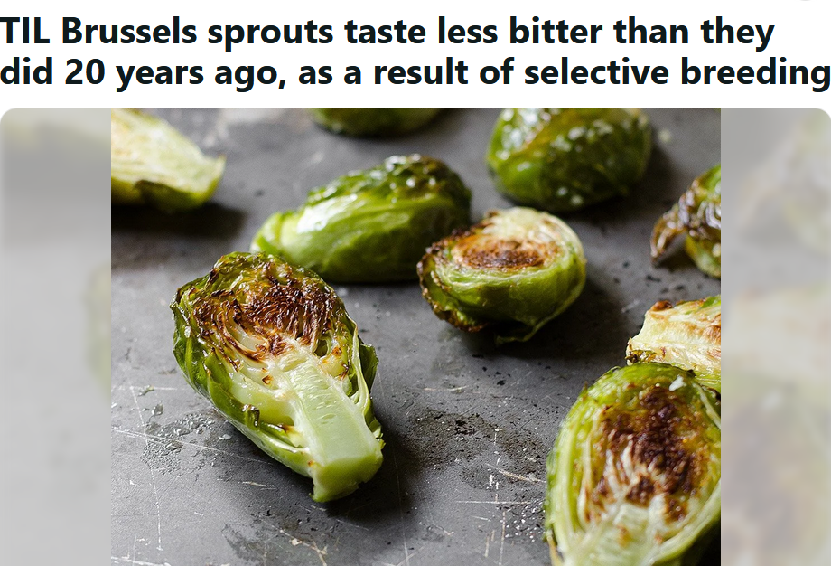
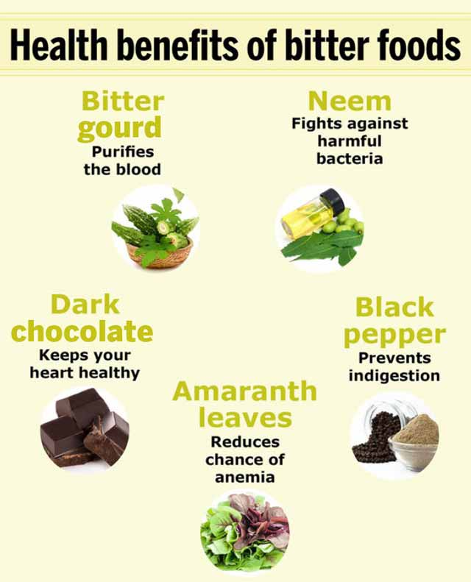

Slide 22
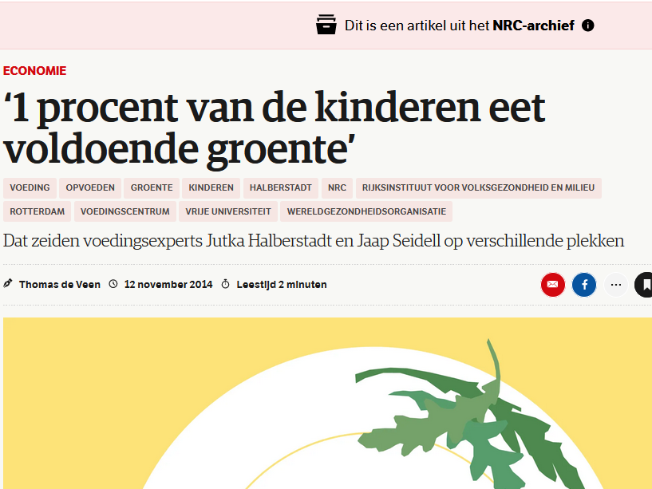

Slide 23
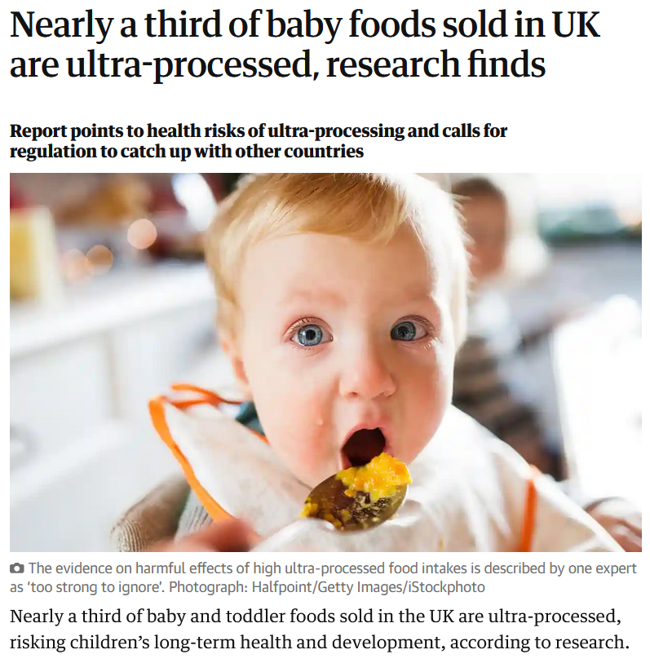
Guardian, June 8th 2023

Slide 24
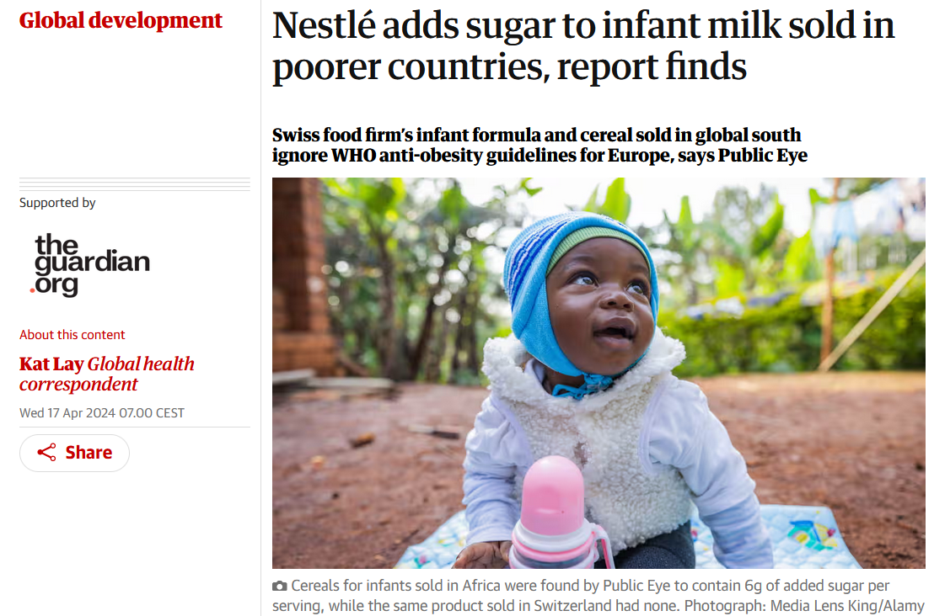

Slide 25
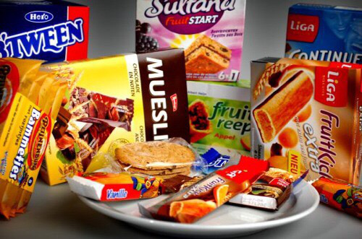
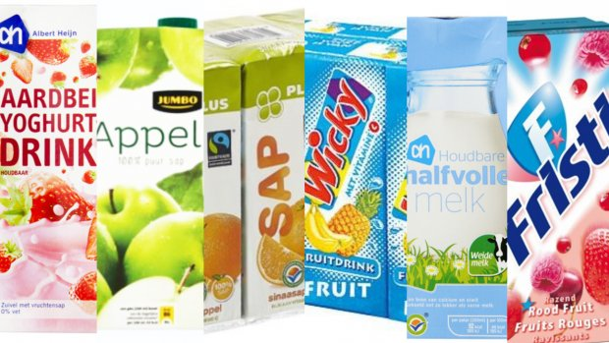

Slide 26
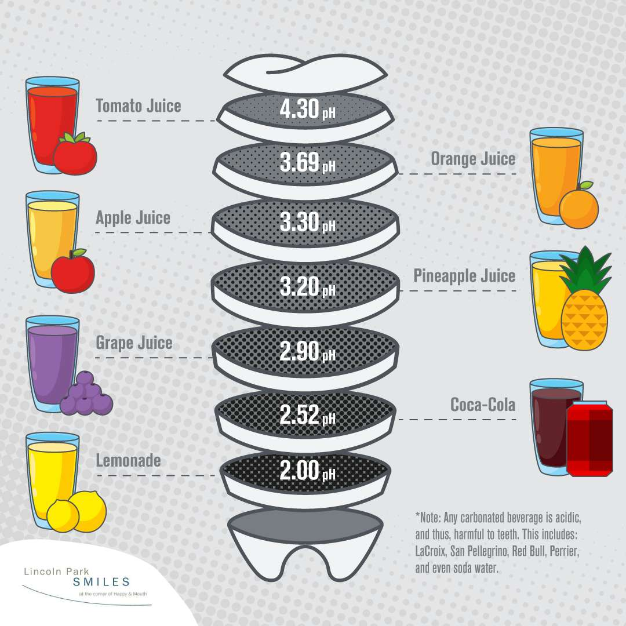

Slide 27
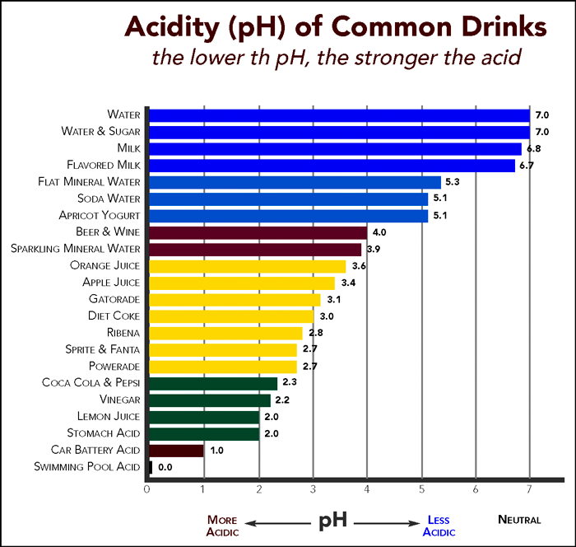

Slide 28
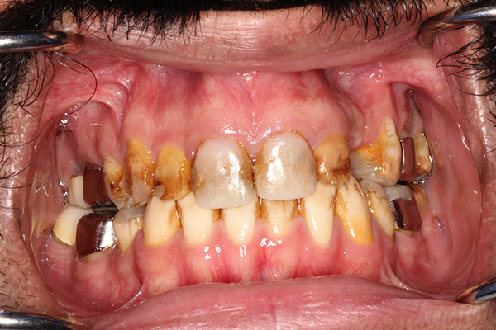
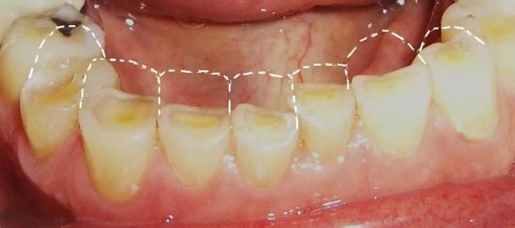

Slide 29
TNO 2018
Cariës blijkt net als in de twee voorgaande onderzoeksjaren nog altijd zeer veel voor te komen onder jongeren: een kwart van de 5-jarigen, 40% van de 11-jarigen, twee derde van de 17-jarigen en vier vijfde van de 23-jarigen hebben cariës tot in het tandbeen. Daarnaast is er een sterke toename van gebitsslijtage: een vijfde van de 17-jarigen en ruim de helft van de 23-jarigen vertoont slijtage tot in het tandbeen. Meestal is erosie de oorzaak van gebitsslijtage; erosie komt door het nuttigen van zuren in zoete voedingsmiddelen en dranken.

Slide 32
Nutrients and dental health
1. Calcium. aids in the maintenance of a strong jawbone and the strengthening of tooth enamel. Calcium is also important for tooth growth because it is a component of tooth enamel. Teeth can weaken without enough calcium, which can cause tooth decay and other oral health issues linked to weak teeth.
2. Vitamin C supports the growth and maintenance of strong teeth and gums. Vitamin C is important for oral health since it aids in the synthesis of collagen in dentin. In addition, vitamin C promotes the development and maintenance of teeth and guards against gingival inflammation and disorders including gingivitis and scurvy.
3. Potassium aids the body's defense and helps prevents the deterioration of the jaw and other dental structures. Potassium can also makes blood clotting more effective and increases wound healing. These benefits can help people whose gums bleed periodically or when they floss.

Slide 33
Nutrients and dental health
4. Phosphorus aids in the preservation and regeneration of tooth enamel. Phosphorus combines with calcium to create hydroxyapatite, the primary building block of dental enamel. Phosphorus is crucial for the body's complete absorption of calcium, as the human body cannot use calcium without it.
5. Vitamin D aids in the absorption, transport, and deposit of calcium into the bones that sustain the teeth. Additionally, vitamin D increases the mineral concentration of bones, which makes them tougher and more fracture-resistant.
6. Vitamin A aids in the formation of keratin, a protein that is present in tooth enamel and is crucial for the defense and strength of your teeth. Additionally, vitamin A prevents dry mouth and supports the health of your mouth's mucous membranes. Vitamin A also stimulates and maintains saliva production. Saliva is a crucial element in dental hygiene because it removes dangerous bacteria and food debris from the spaces between teeth and gums.
7. Vitamin K binds calcium to teeth and bones, which strengthens them and makes them less brittle. In addition, vitamin K aids in the synthesis of osteocalcin, an essential protein for the development and maintenance of healthy bones. Thus, you may bleed more frequently if you don't get enough vitamin K since it takes longer for your body to repair after an injury.

Slide 34
