Slide 1
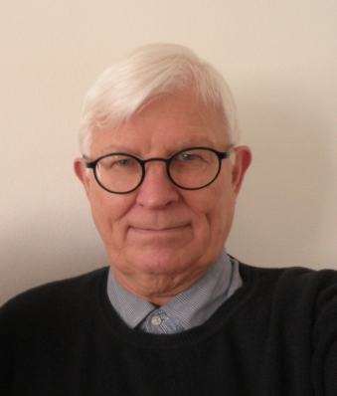
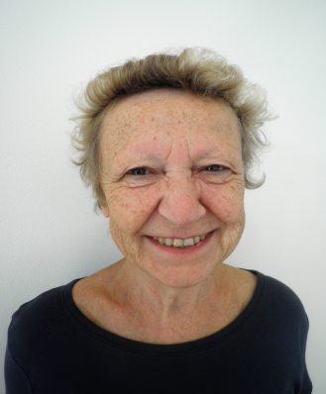

Thank you so much
Mauri Erik Christian Christiansen, DDS 1969
Jette Christiansen, DDS 1969

Slide 2
What I will tell you today
History and principles of the Nexø Method
Nexø in The Netherlands
Denmark today
The Netherlands today

Slide 3
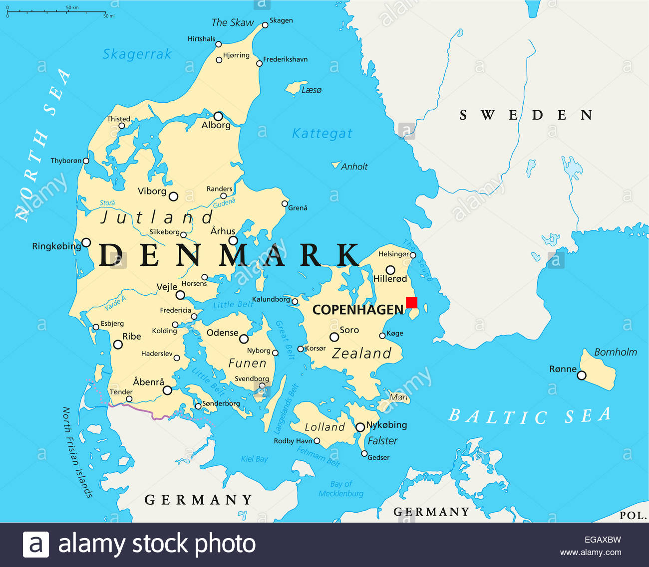
1972:
Danish Act on Child Oral Health Care
Nexø

Slide 4
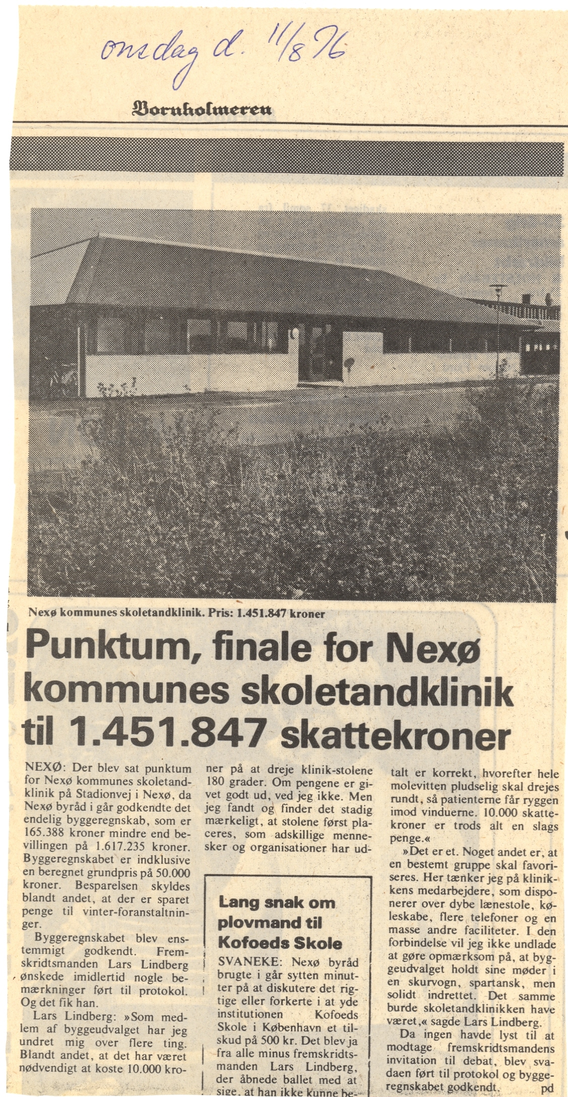
1976 Nexø: M.E.C. Christiansen Chief Dentist
J. Christiansen Dentist for children

Slide 5
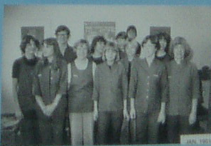
The Nexø Clinic in 1981
We drilled and filled
Extension for prevention

Slide 6
Danish National data. Danish Health Authority

Slide 7
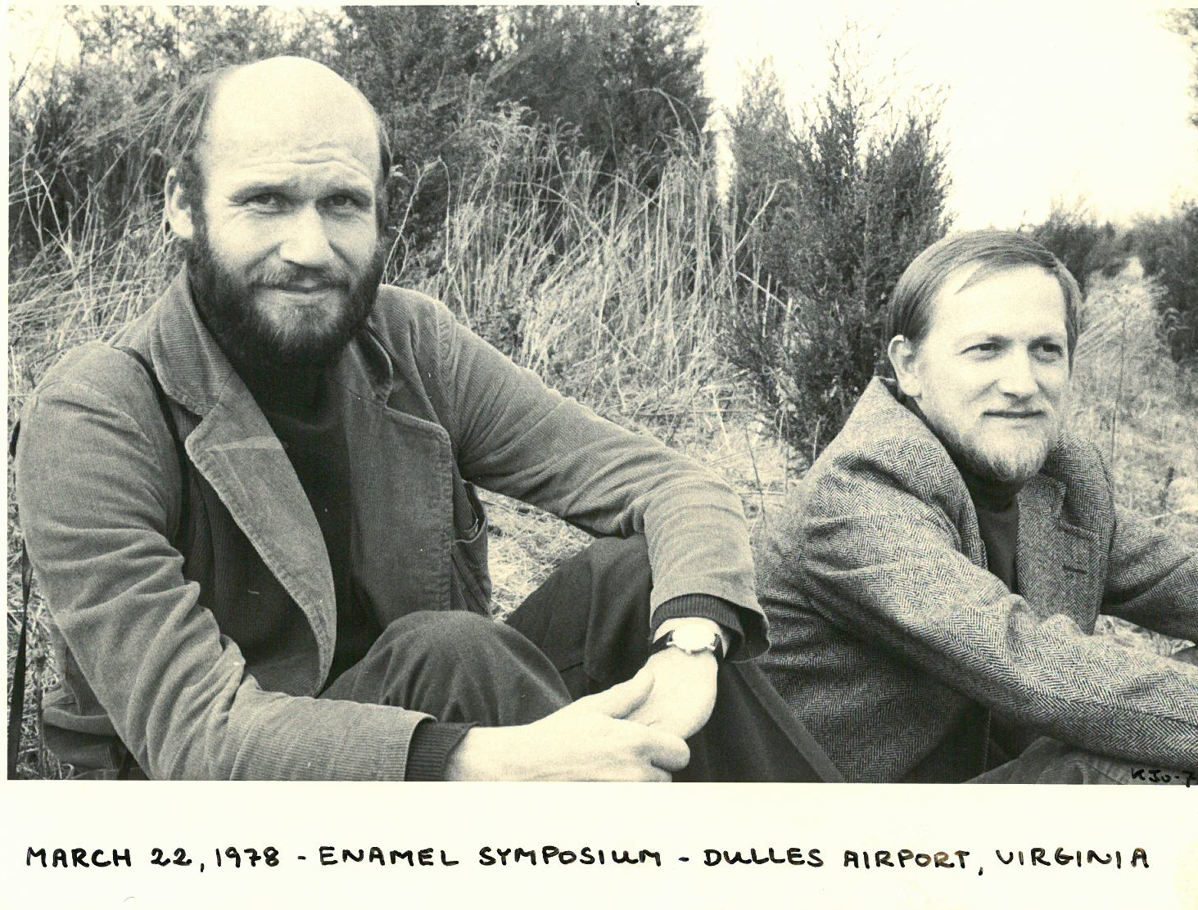
Thylstrup
Fejerskov
Rational use of fluorides in caries prevention A concept based on possible cariostatic mechanisms
Fejerskov O, Thylstrup A, Larsen MJ, Acta Odontol Scand 1981
1981: Thylstrup is invited by the Chief dentist MEC Christiansen to the Nexø Clinic
1981: Thylstrup becomes Professor at the Dep. of Cariology, Uni. of Copenhagen
Dental fluorosis: Thylstrup–Fejerskov Index, 1978

Slide 8
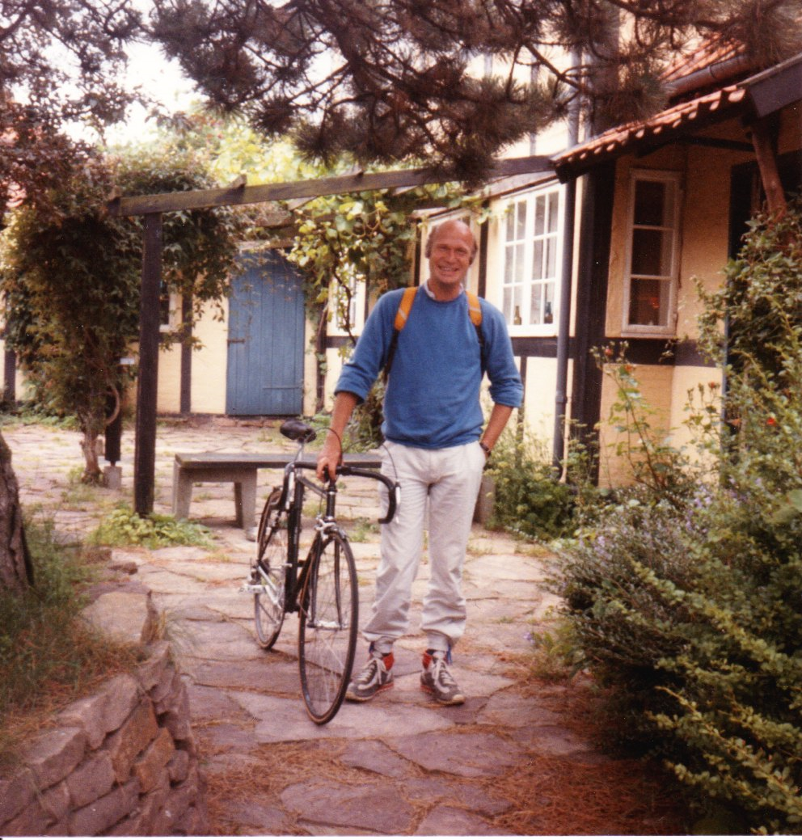
This was the beginning of a process of innovation
1981: ”You drill too much and too early”

Slide 9
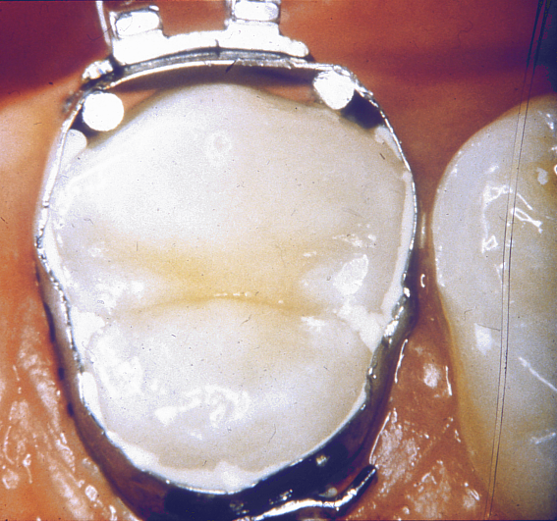
The banding studies
In vivo Caries Models--- Mechanisms for Caries Initiation and Arrestment
A Thylstrup, C Bruun, L Holmen Adv Dent Res 8(2):144-157, July,1994

Slide 10
Conclusion: ”Regular mechanical disturbance of plaque is able to
suppress bacterial activity and hence caries development.”
The Effect of Regular Professional Plaque Removal
Caries signs
Caries progression
in teeth with
undisturbed plaque
Visible
Micro-
scopical
Caries progression
in teeth with
weekly plaque removal
1
2
3
4
5
Weeks

Slide 11
Mineral loss (symptom)
Total
destruction
Cavity
formation
White spot
Visible
Light
microscopical
Subclinical
Ultra
structural
Time

Slide 12
Mineral loss (symptom)
Total
destruction
Cavity
formation
White spot
Visible
Light
microscopical
Subclinical
Ultra
structural
Time

Slide 13
Mineral loss (symptom)
Total
destruction
Cavity
formation
White spot
Visible
Light
microscopical
Subclinical
Ultra
structural
Time

Slide 14
Mineral loss (symptom)
Total
destruction
Cavity
formation
Plaque removal
White spot
Visible
Light
microscopical
Subclinical
Ultra
structural
Time

Slide 15
Mineral loss (symptom)
Total
destruction
Cavity
formation
White spot
Visible
Light
microscopical
Plaque removal
Subclinical
Ultra
structural
Time

Slide 16
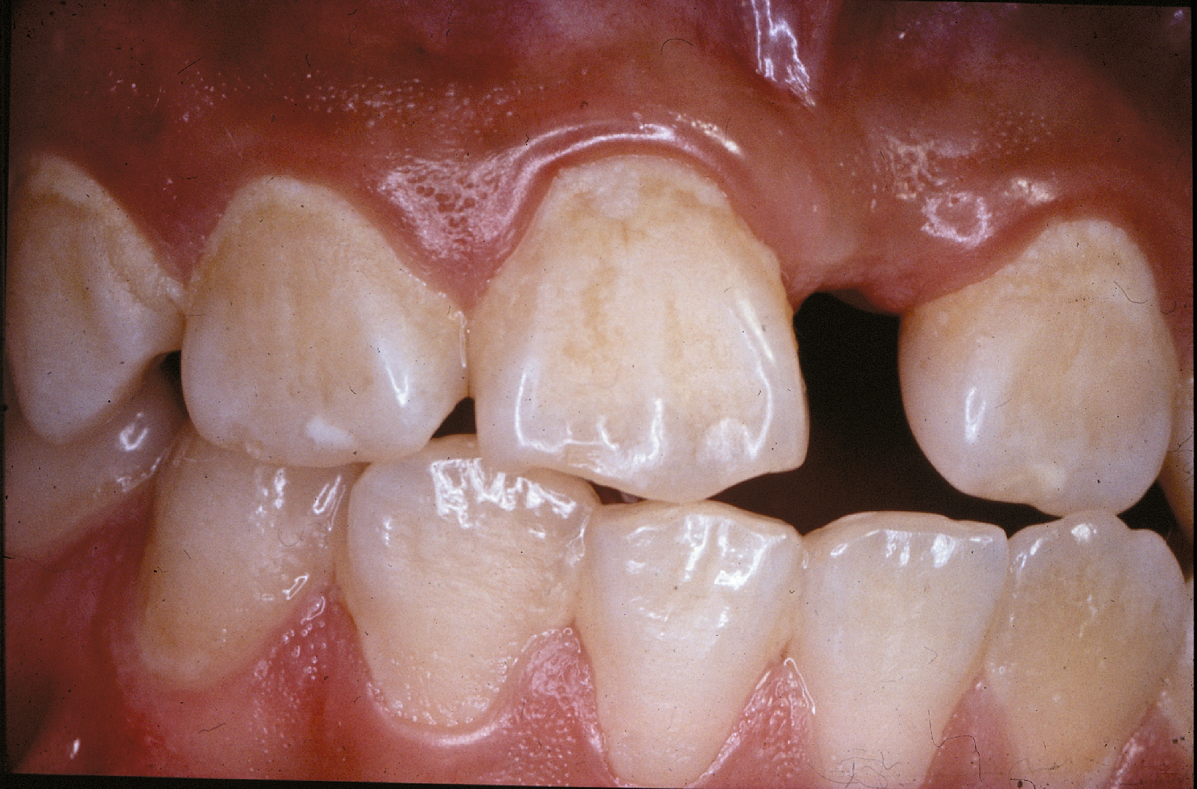
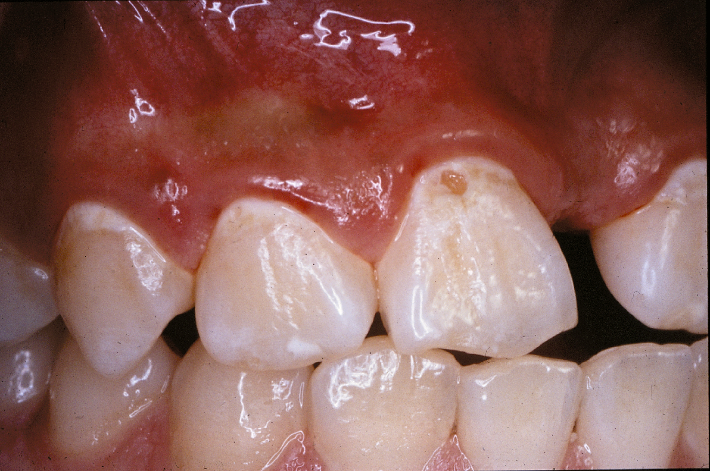
Plaque stagnation areas
Caries is a localized disease

Slide 17
The final step in the innovation proces was ……
1987: A part of the PhD study of J Carvalho was carried out at the Nexø Clinic
The eruption period is critical for caries initiation and progression

Slide 18
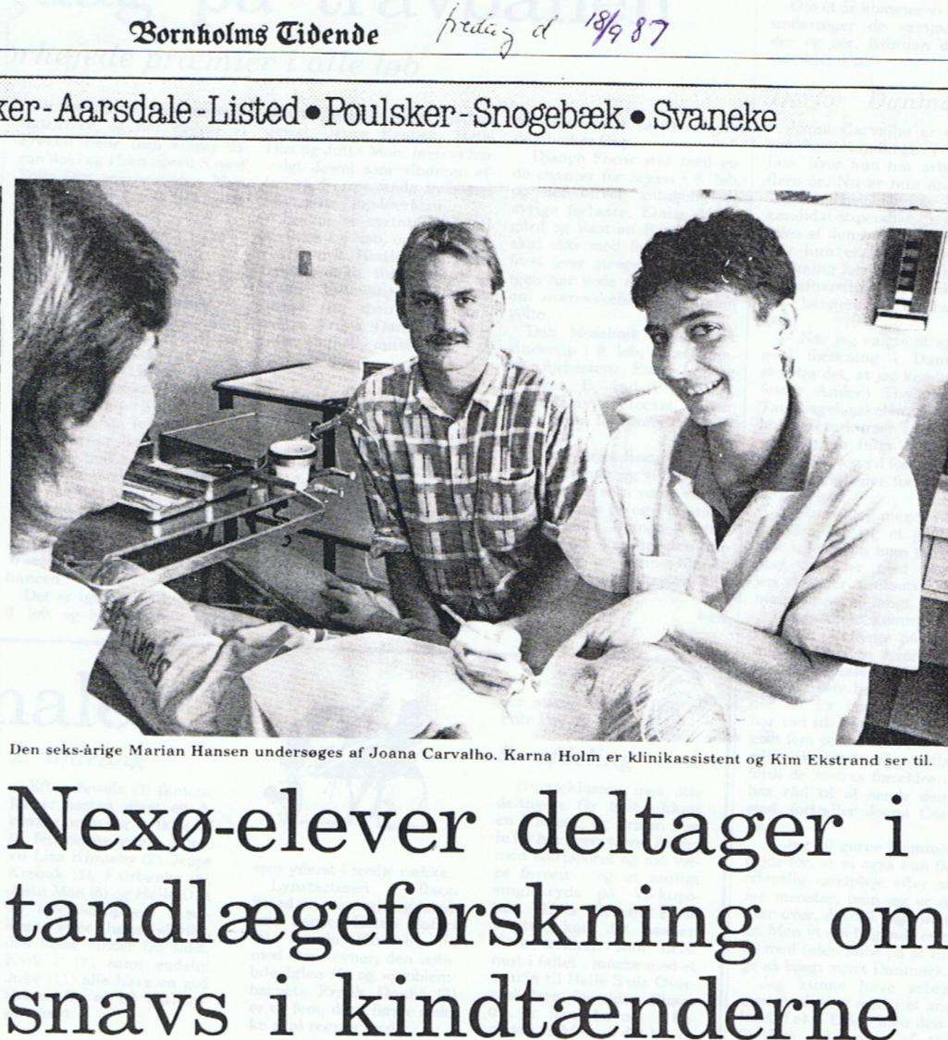
We need a treatment plan for erupting 1. permanent molars
We go around in Denmark and give courses
You must join the ORCA congresses
Thylstrup: These principles are for
the whole dentition

Slide 19
The Nexø Method
A dental health care program
based on individualized non-operative caries treatment of children and adolescents aged 0-18
Aim
To maintain sound teeth
without fillings and with as few sealants as possible
using the fewest resources possible

Slide 20
Method
1. Education of parents and children
in understanding dental caries as a localized disease
2. Training in adequate plaque removal
3. Early professional non-operative intervention
Dosed at individually assessed recalls
according to diagnosis and risk assesssment:
Caries progression
Cooperation
Permanent molars in eruption

Slide 21
Assessment of recall-intervals
 | 2 points | 1 point
Cariesprogression | Yes | No
Cooperation | Inadequate | Adequate
4 points: 1 - 3 Months
3 points: 4 - 8 Months
2 points: 8 -12 Months
Permanent molars in eruption < 4 months

Slide 22
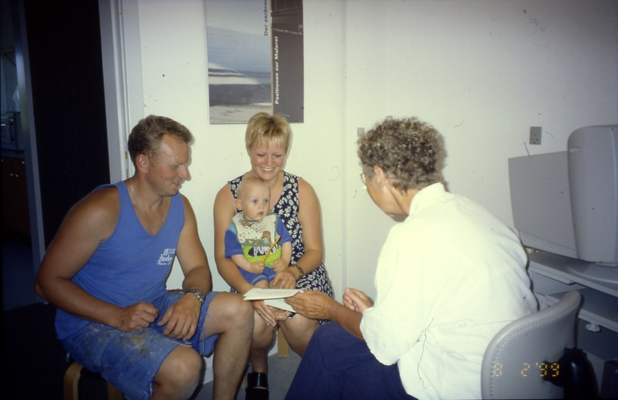
The Nexø method
Nexø 1999

Slide 23
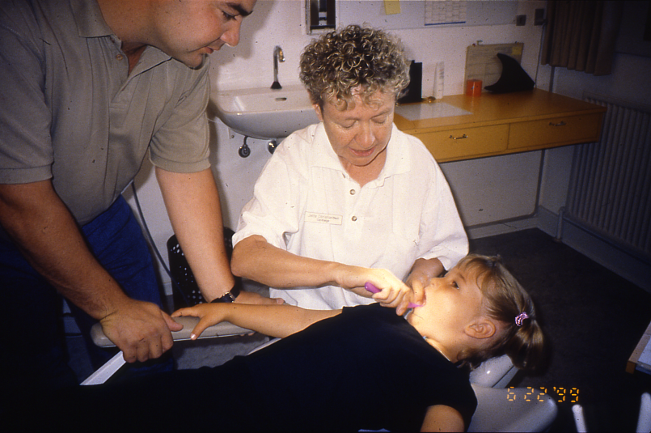
The Nexø method

Slide 24
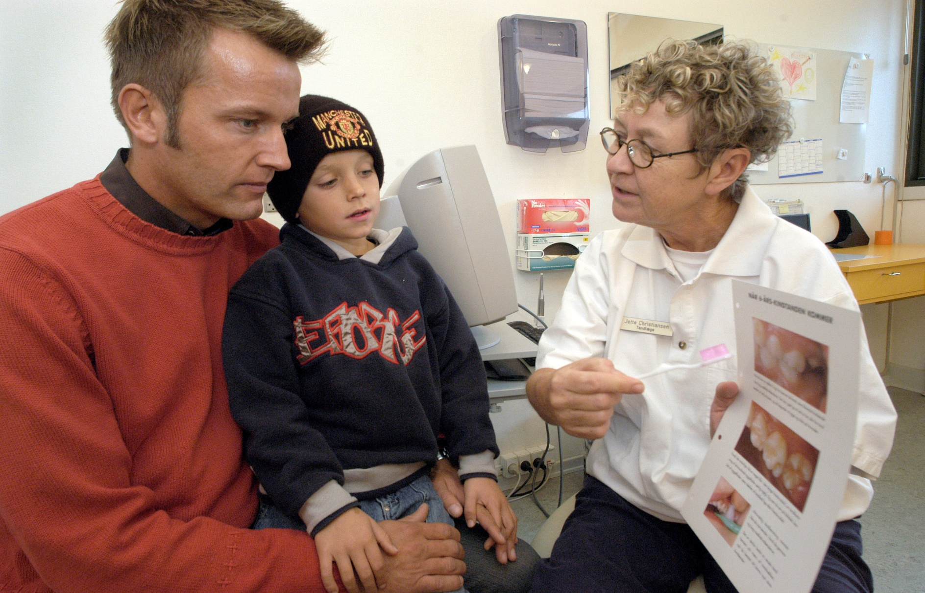
The Nexø method

Slide 25
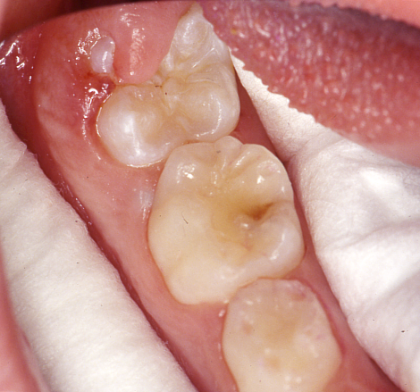
The Nexø method
Early professional non-operative intervention
Clinical procedures:
1. Removal of remaining plaque
Rubbercup/rotating tuft
+ dental floss
2. Cottonrolls and drying
3. Visual examination:
Active caries: Specific education
Topical Fluoride
On indication: Fissure sealing
4. New recall interval

Slide 26
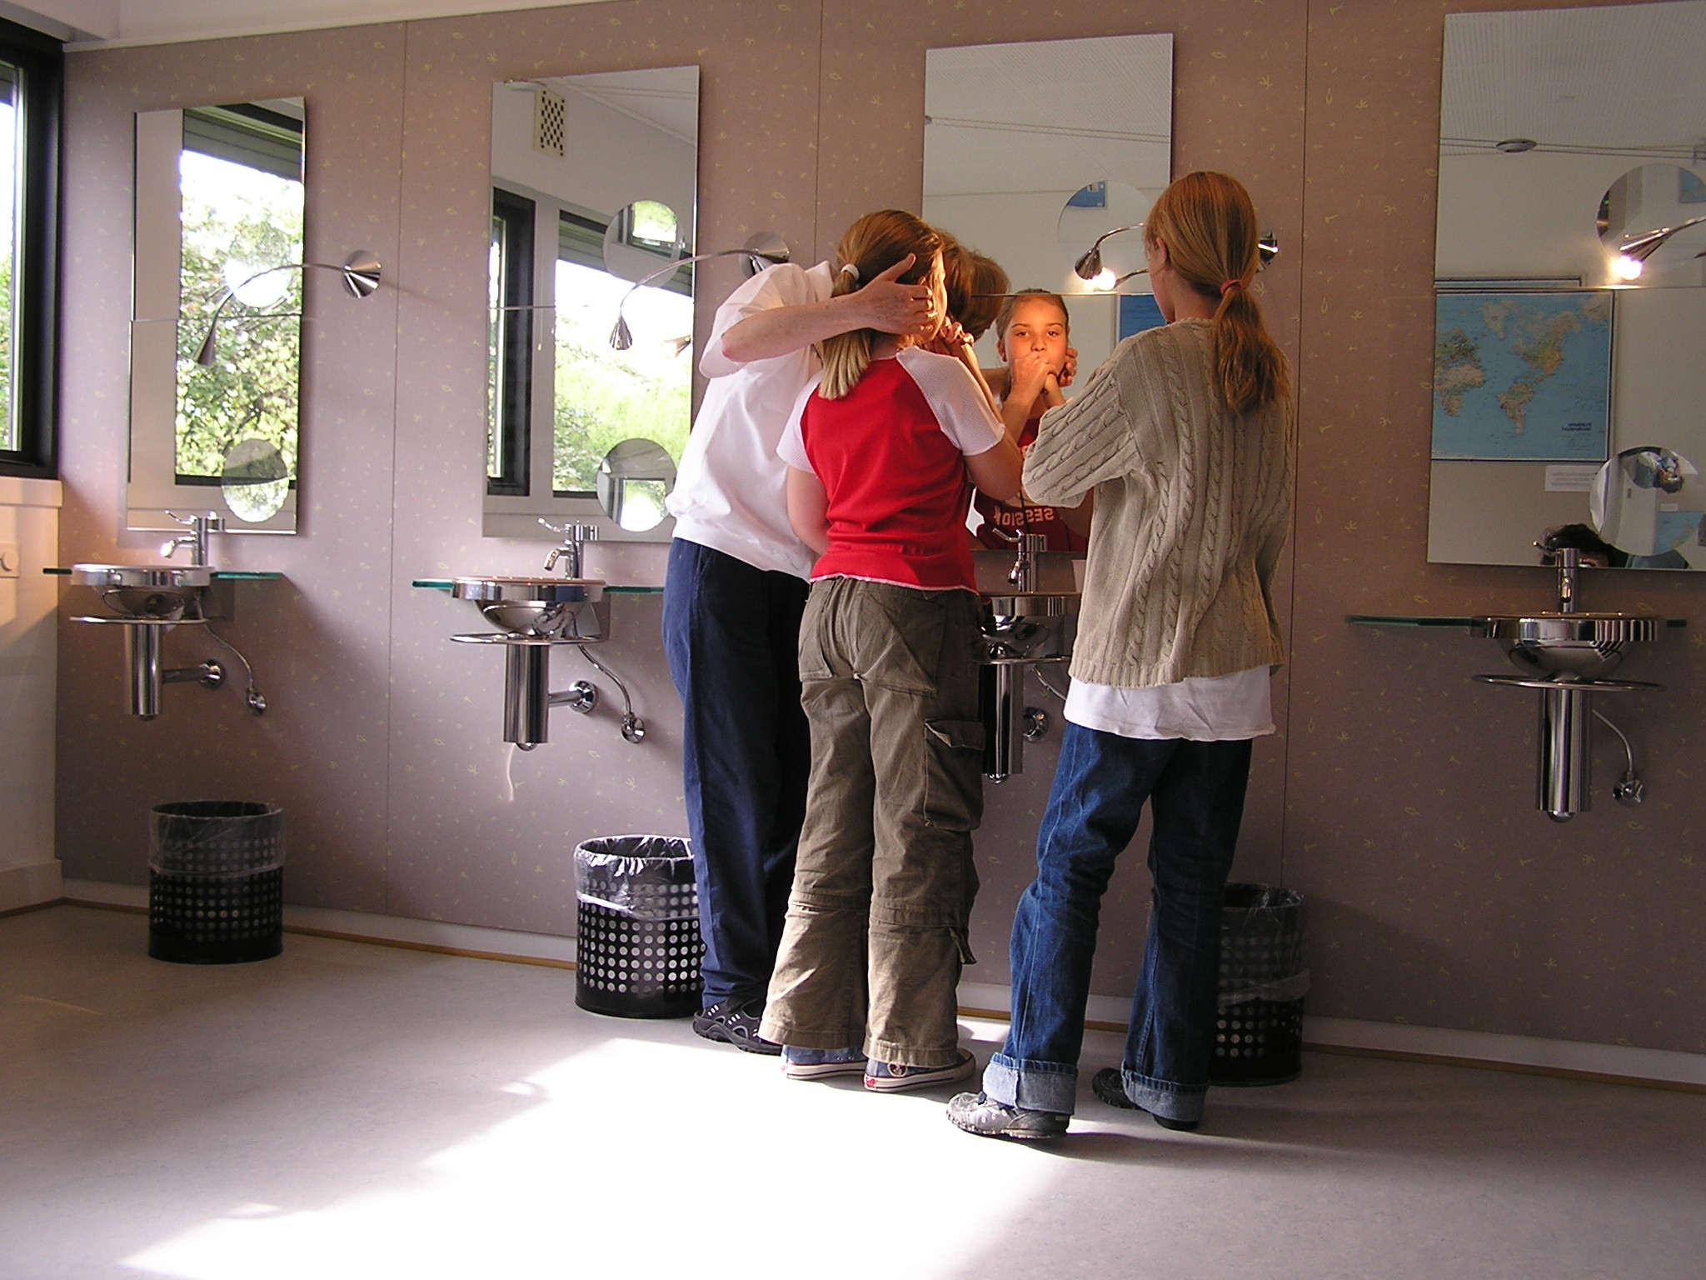
The Nexø method

Slide 27
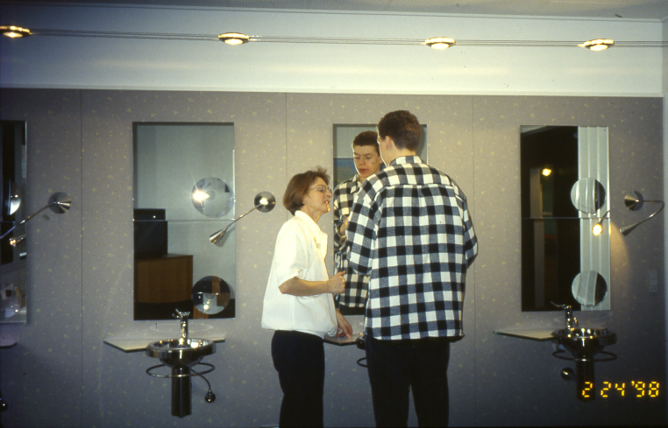
The Nexø method
Am I good enough to disturb the bacteria in my stagnation areas?
A Dutch boy
Nexø 1998

Slide 28
The Nexø Clinic in 1981

Slide 29
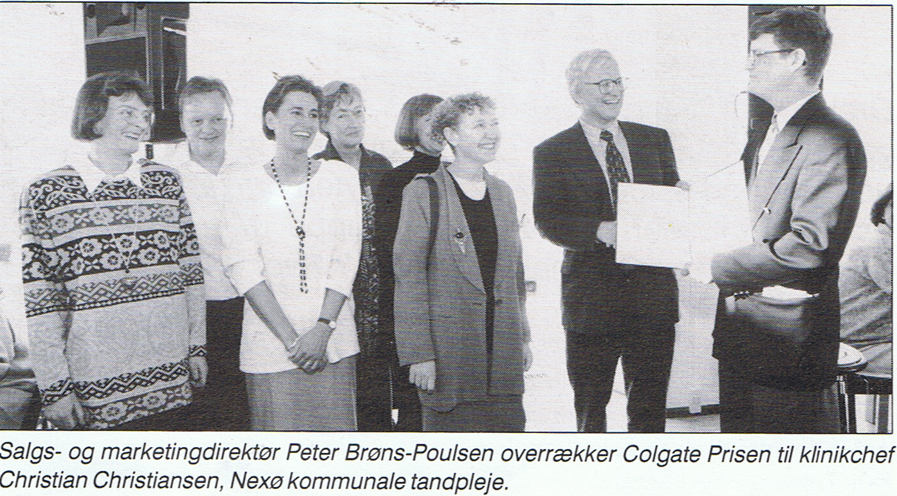
Colgate Prize Denmark 1994

Slide 30
Promoting changes in clinical practice. Treatment time and outcome studies in a Danish public child dental health clinic
Thylstrup A, Vinther D, Christiansen J. Community Dent Oral Epidemiol 1997; 25; 126-34

Slide 31
New strategy

Slide 32
Danish National data. Danish Health Authority

Slide 33
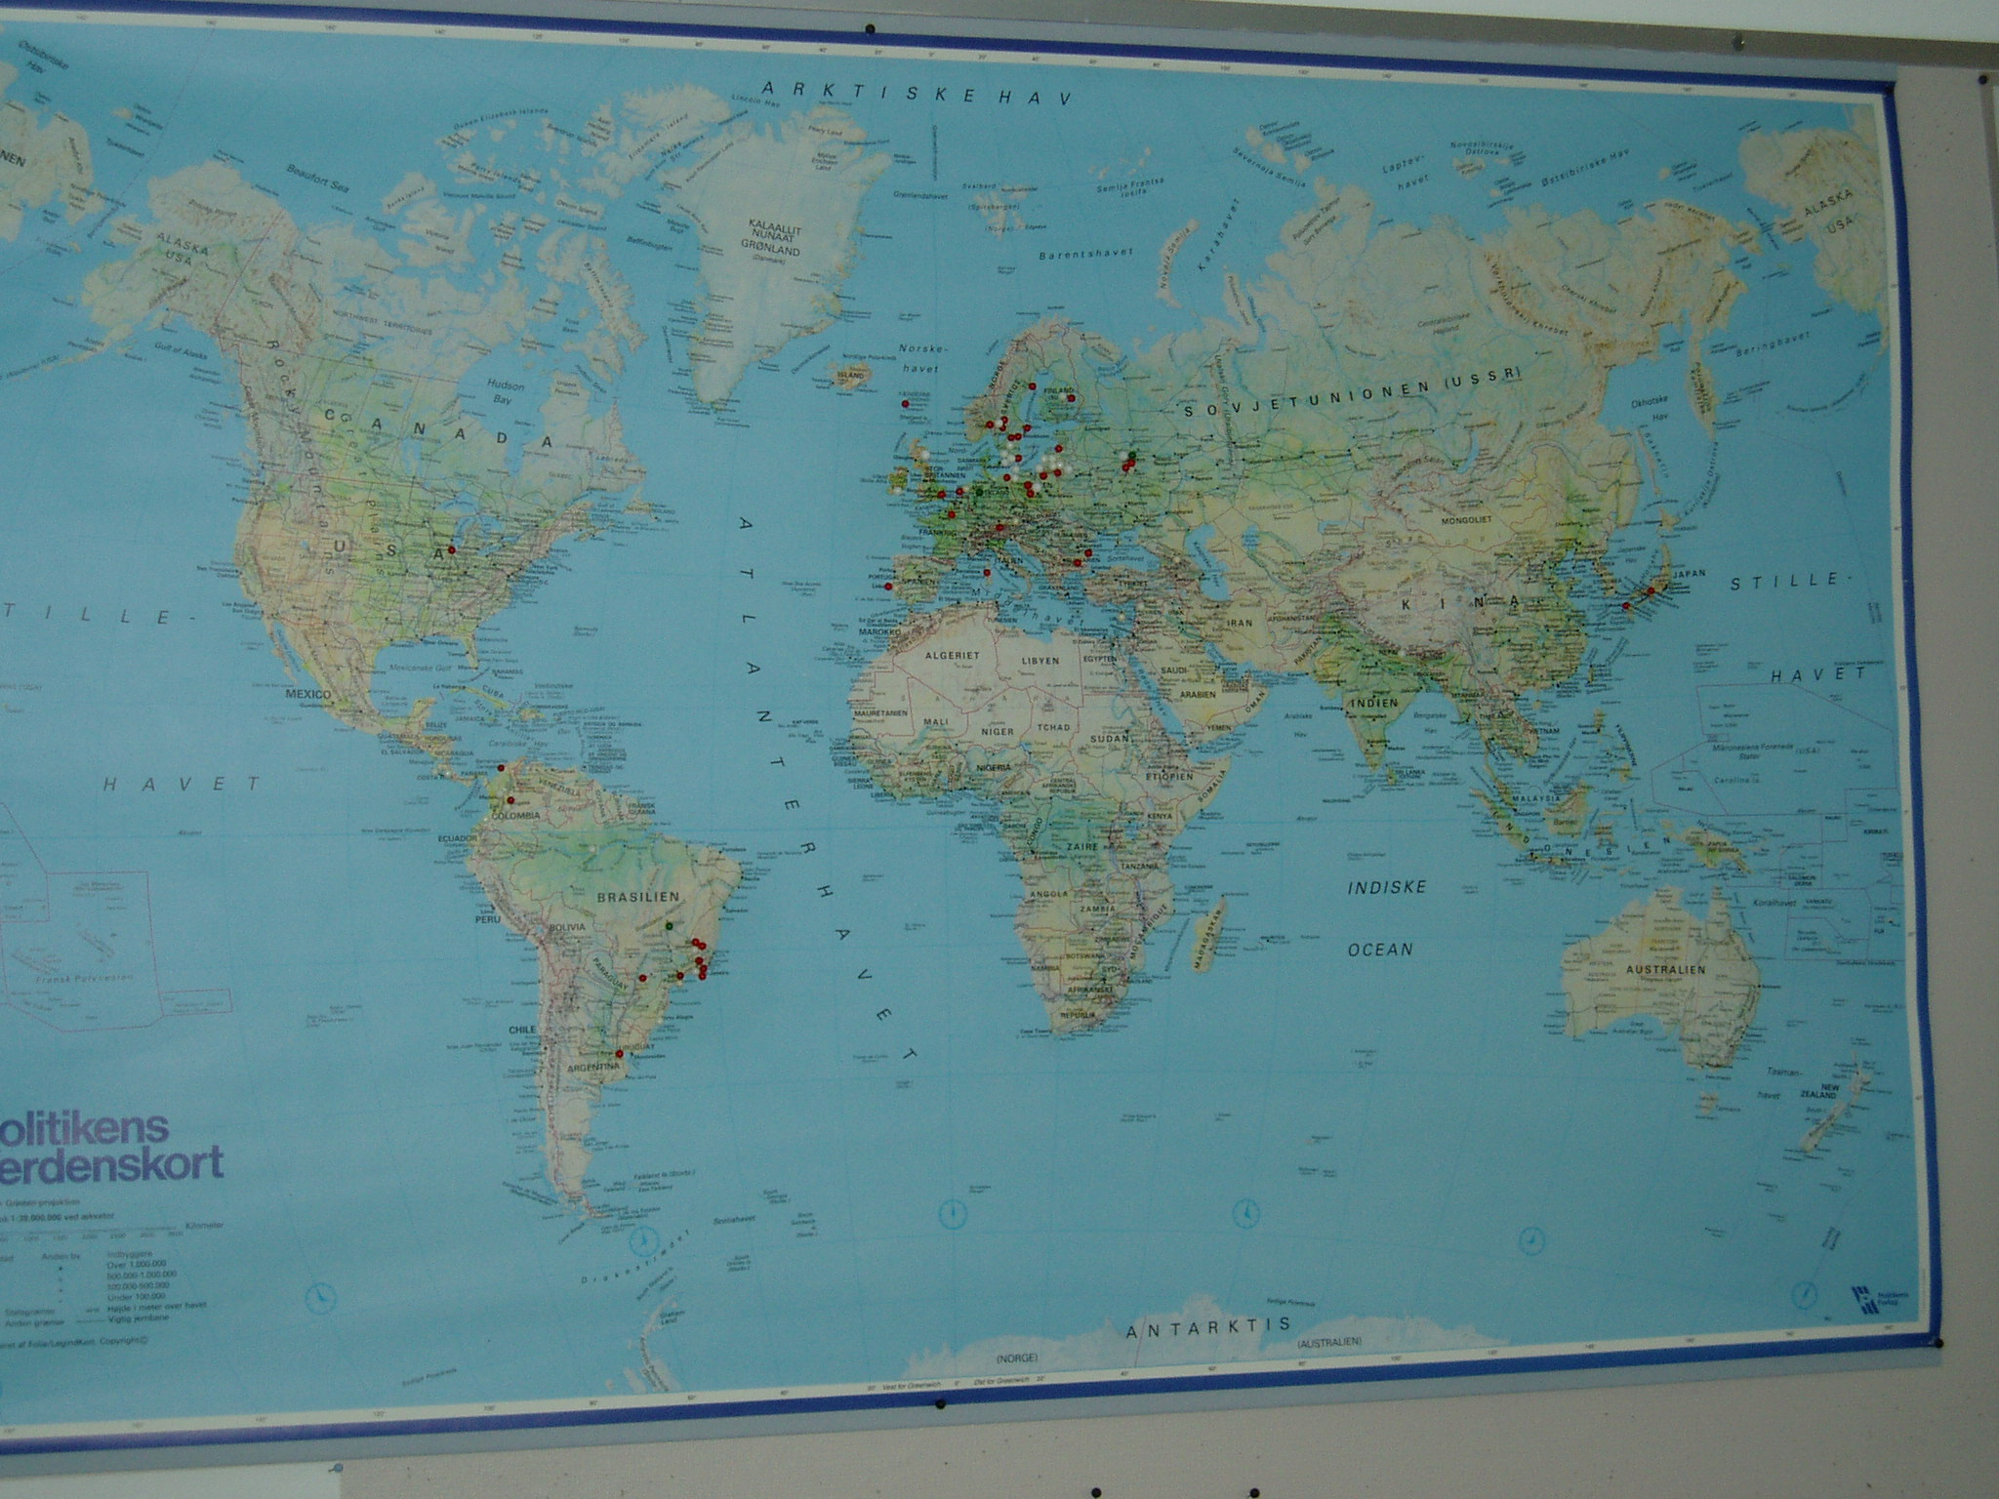
a Non-Operative Caries Treatment Program for Children and Adolescents KR Ekstrand, MEC Christiansen Caries Res 2005
Worldmap 2005
2007-15
= NOCT and P
= NOCTP
The Nexø Method
A demonstration project 1987–2005

Slide 34
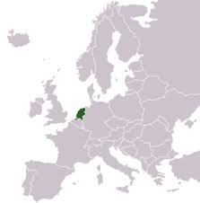
Nexø in the Netherlands
YOU were the ones who really wanted improvements, your ears were open
X

Slide 35
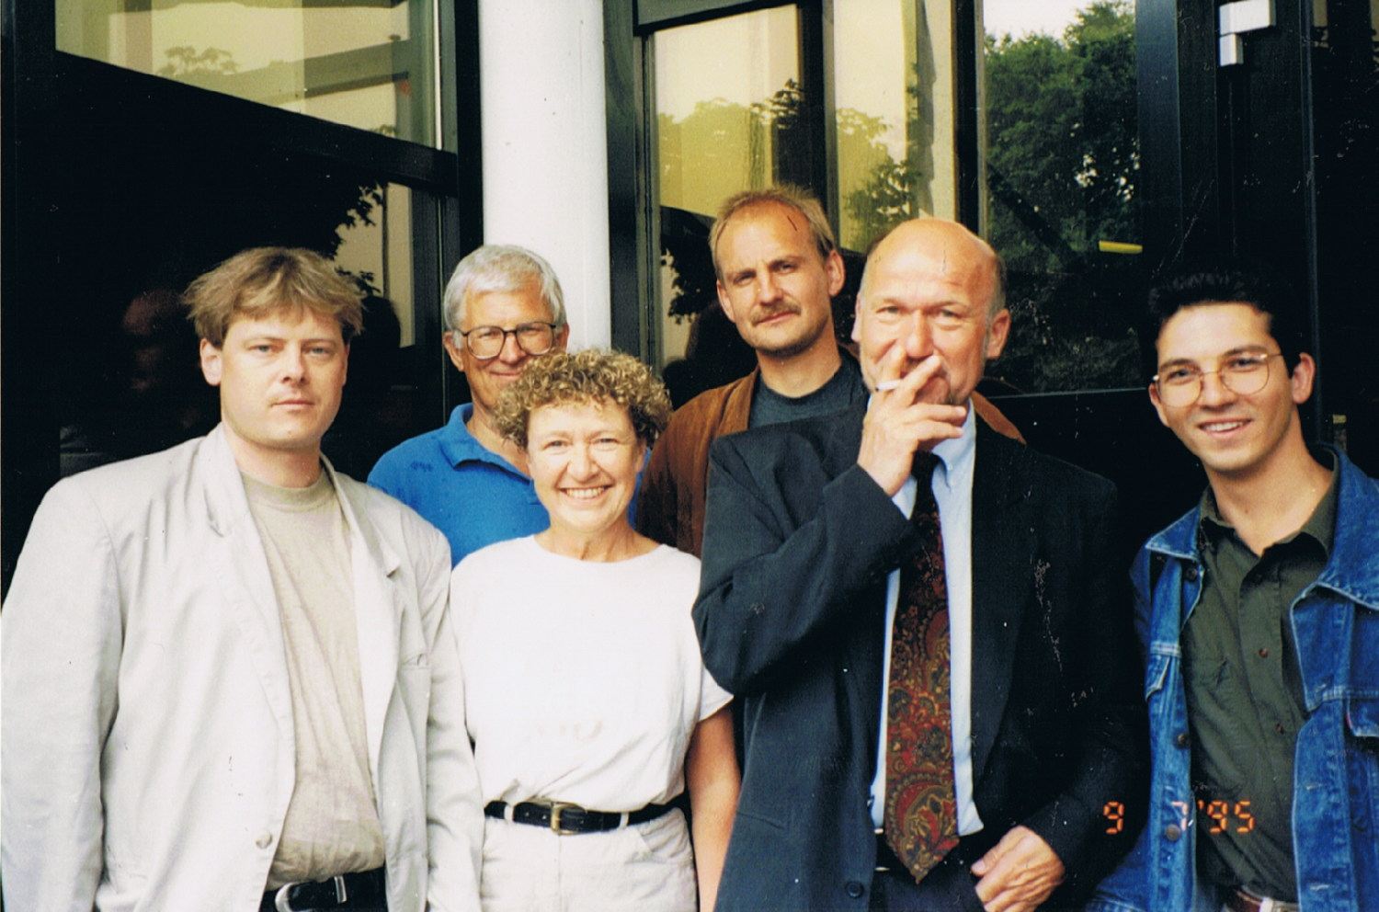
ORCA 1995 The Netherlands Noordwijkerhout

Slide 36
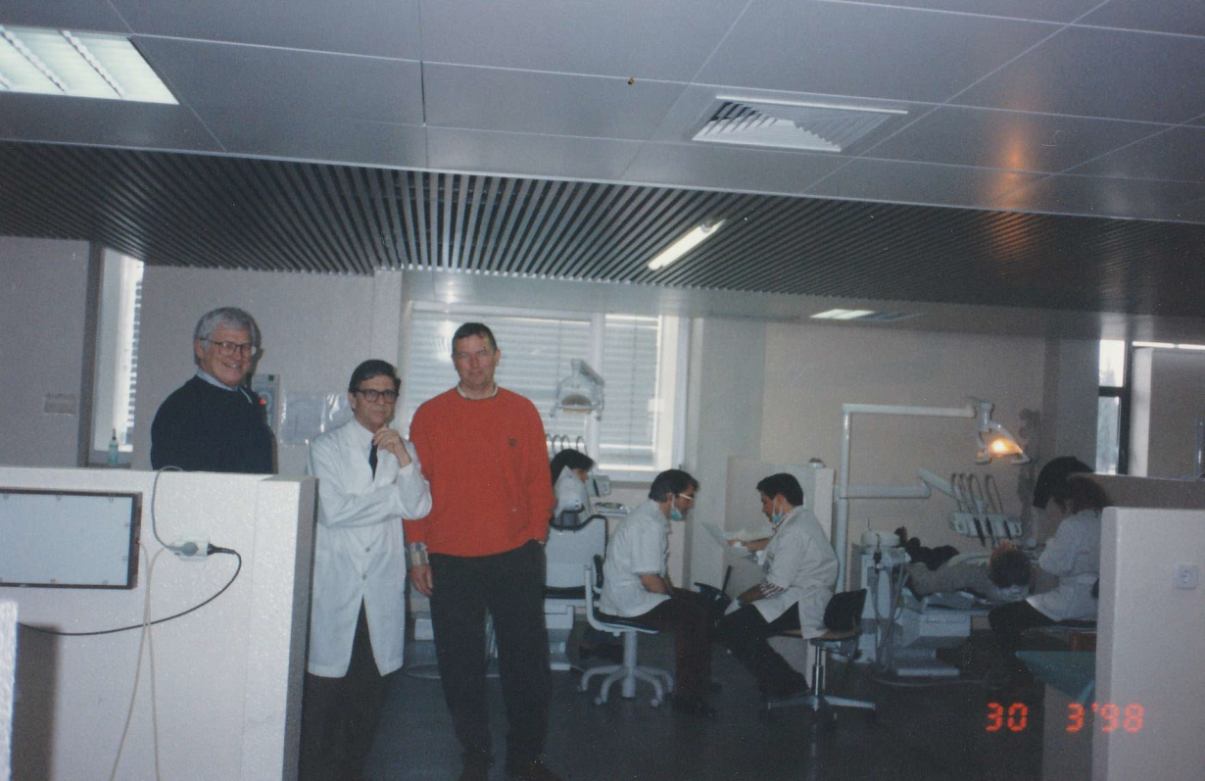
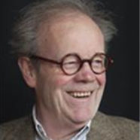
1996 -
ORCA congresses, International lectures
1998
2001
Nexø was invited to the Paediatric Dep. ACTA
A delegation from ACTA visited The Nexø clinic

Slide 37
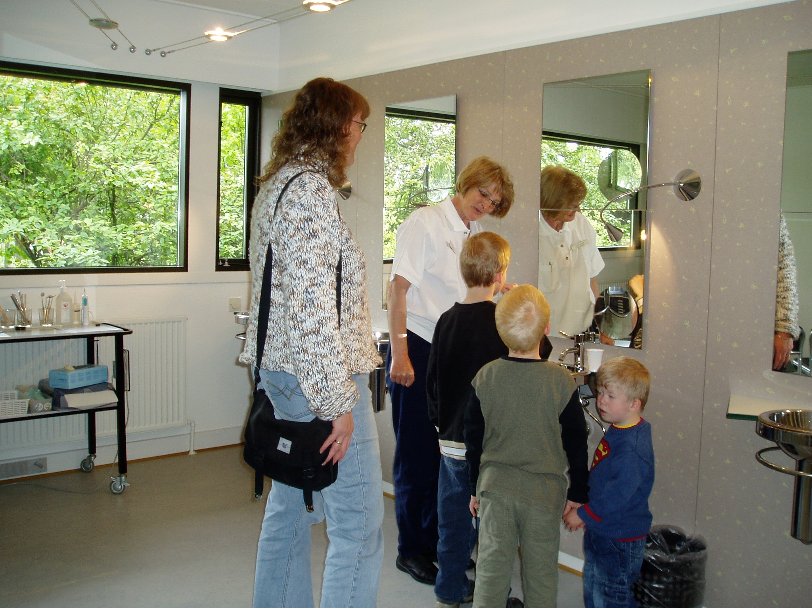
2001
A delegation from ACTA visited The Nexø clinic

Slide 38
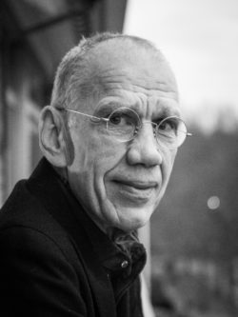
2001
A delegation from ACTA visited The Nexø clinic
René Gruythuysen
Non-Restorative Cavity Treatment of primary teeth
Effective and child-friendly

Slide 39
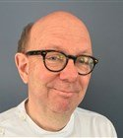
2005
NVT Dutch Dental Society Congress 2005
C A R I Ë S
EEN EEUW NA BLACK
Voorzitter NVT
Moderator
Fejerskov: The future lies in the past. Paradigm shifts in cariology
and the consequences for dental care
Nyvad: Clinical caries diagnosis in the wake of Otto Backer Dirks
Ekstrand: The Nexø model: a simple solution for a simle problem?

Slide 40
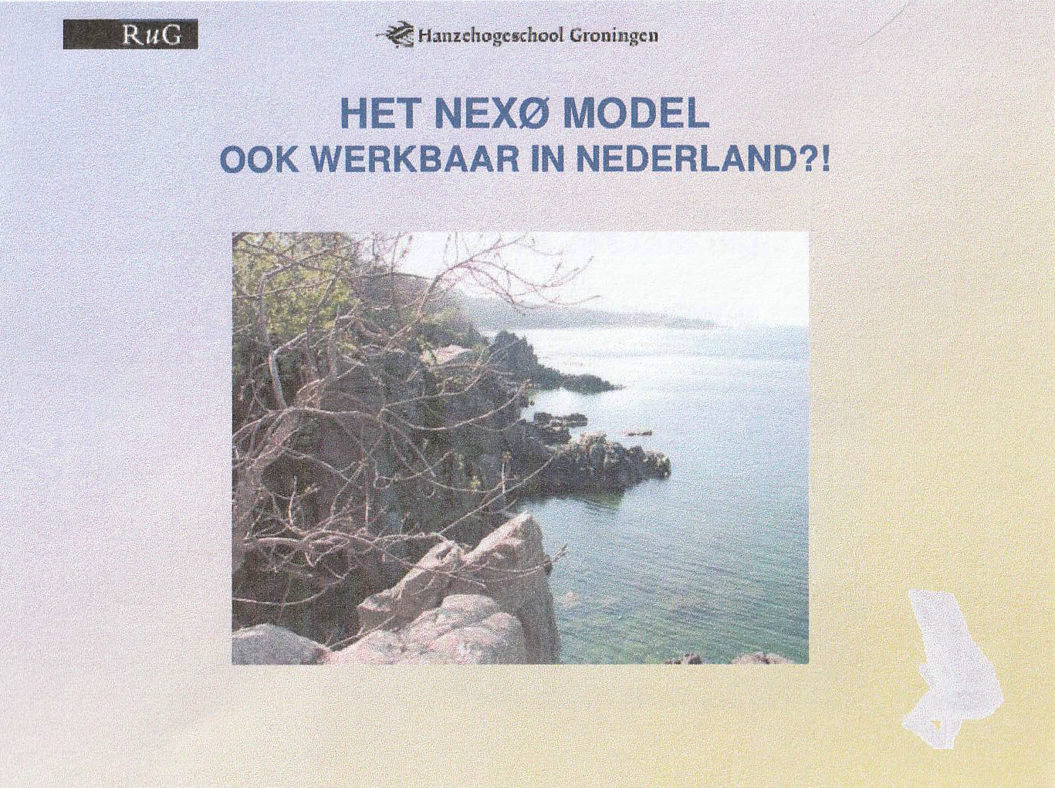
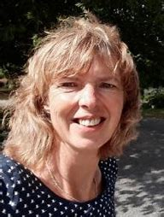
2005
A delegation from Groningen visited The Nexø clinic

Slide 41
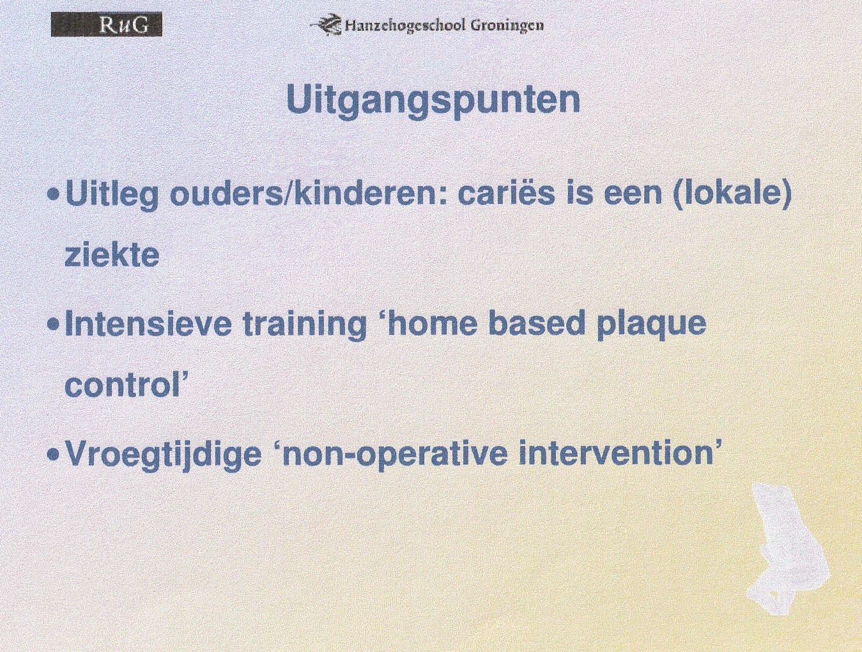
2005
A delegation from Groningen visited The Nexø clinic

Slide 42
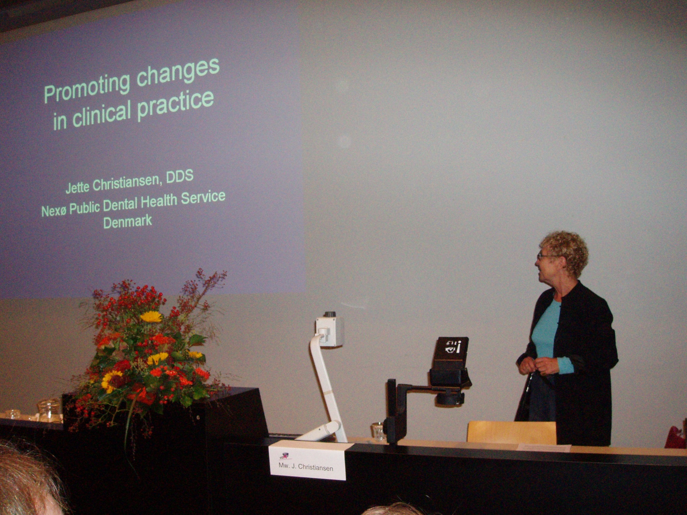
2005
NVM: Conferentie, Utrecht
’Mondhygienist onmisbaar voor verantwoorde mondzorg’

Slide 43
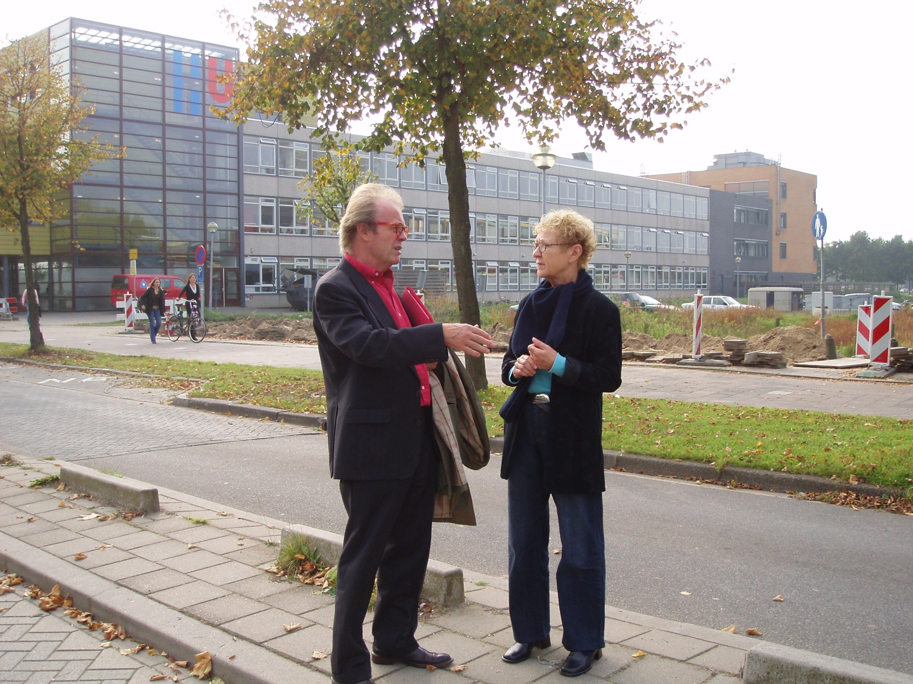
2005
NVM: Conferentie, Utrecht
’Mondhygienist onmisbaar voor verantwoorde mondzorg’

Slide 44
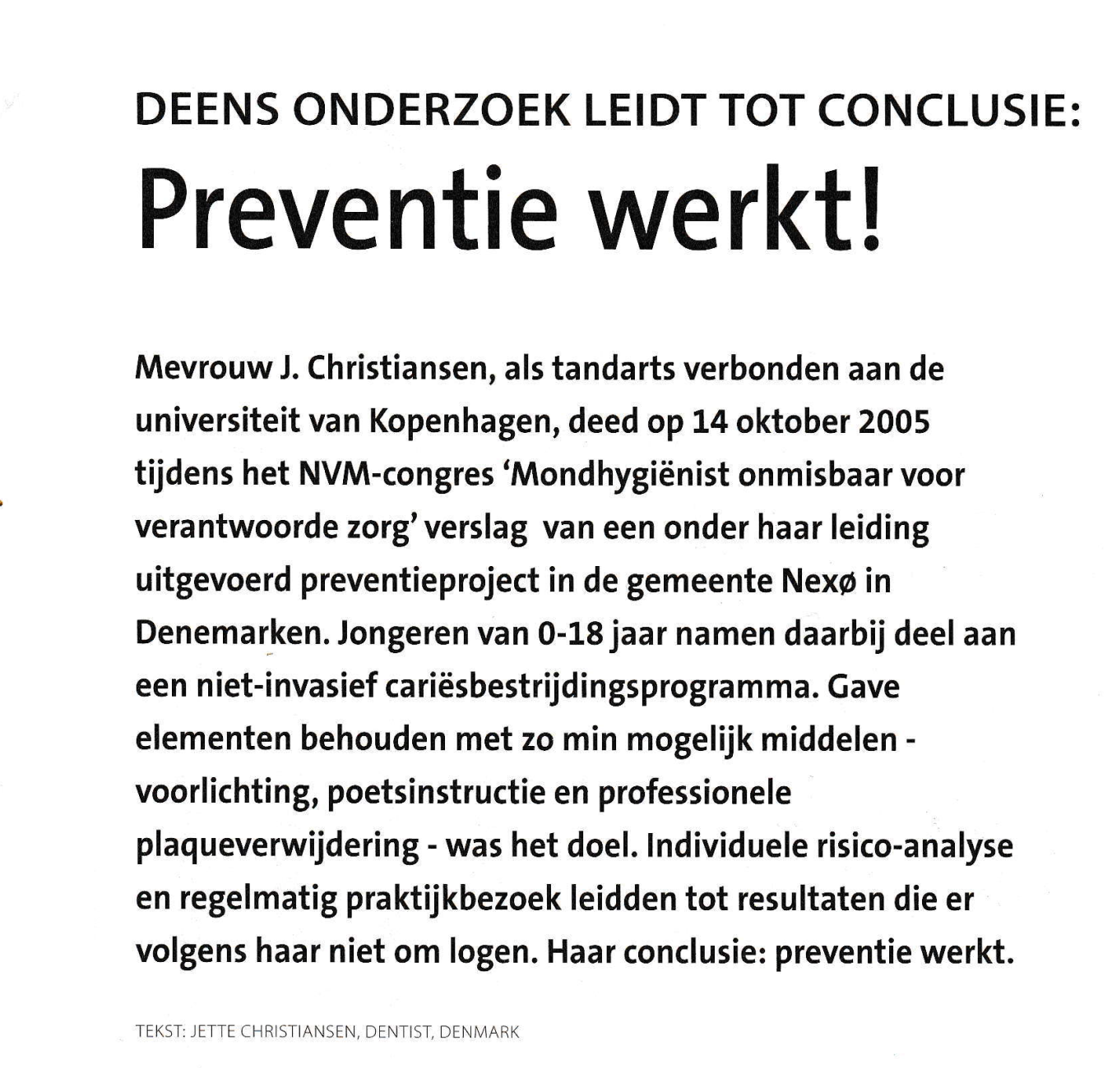
2006
Nederlands Tijdschrift voor
Mondhygiene

Slide 45
Congress, Hoofddorp
2008
Nederlandse
Vereniging
voor
Kindertandheelkunde
VERENIGING TOT
BEVORDERING DER
TANDHEELKUNDIGE
GEZONDHEIDSZORG VOOR GEHANDICAPTEN
Cariës
Welke strategie past wie?
Dr. Jette Christiansen: Lecture and article in Congresverslag:
Nexø, early diagnosis for an appropriate preventive and restorative approach

Slide 46
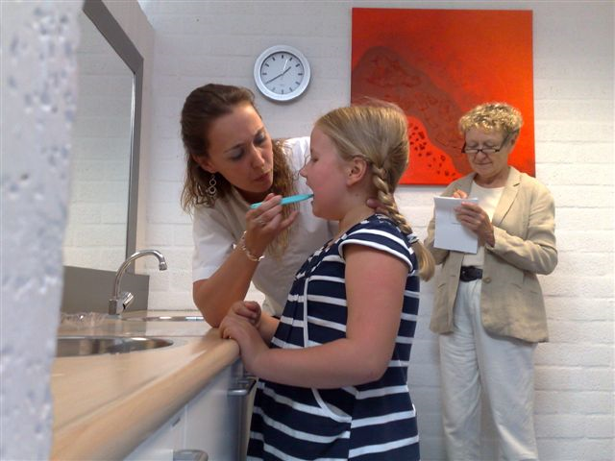
2008
Den Bosch
Postgraduate course offered to teams in the Netherlands involved in the research project testing ”the Nexø Method”

Slide 47
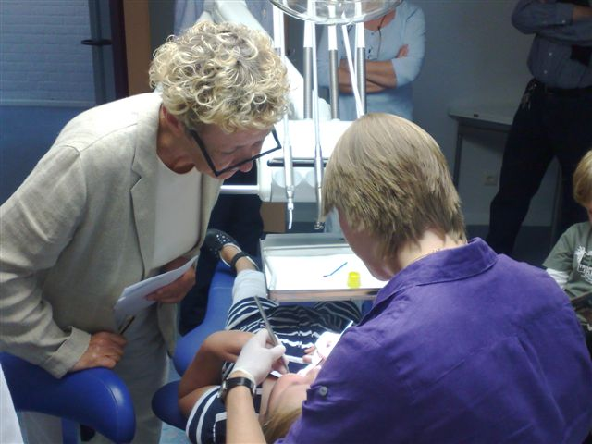
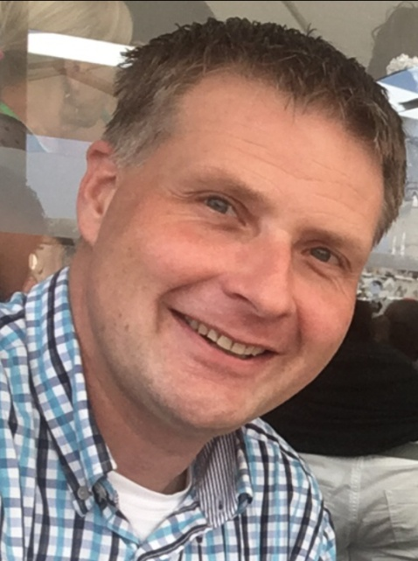
2008
Den Bosch
2008
Postgraduate course offered to teams in the Netherlands involved in the research project testing ”the Nexø Method”

Slide 48
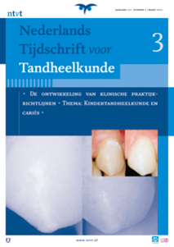
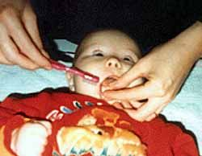
2010
J.P. van Amerongen
W.H. Palenstein
A.J.P. van Strijp
C. van Loveren
R.J.M. Gruythuysen

Slide 49
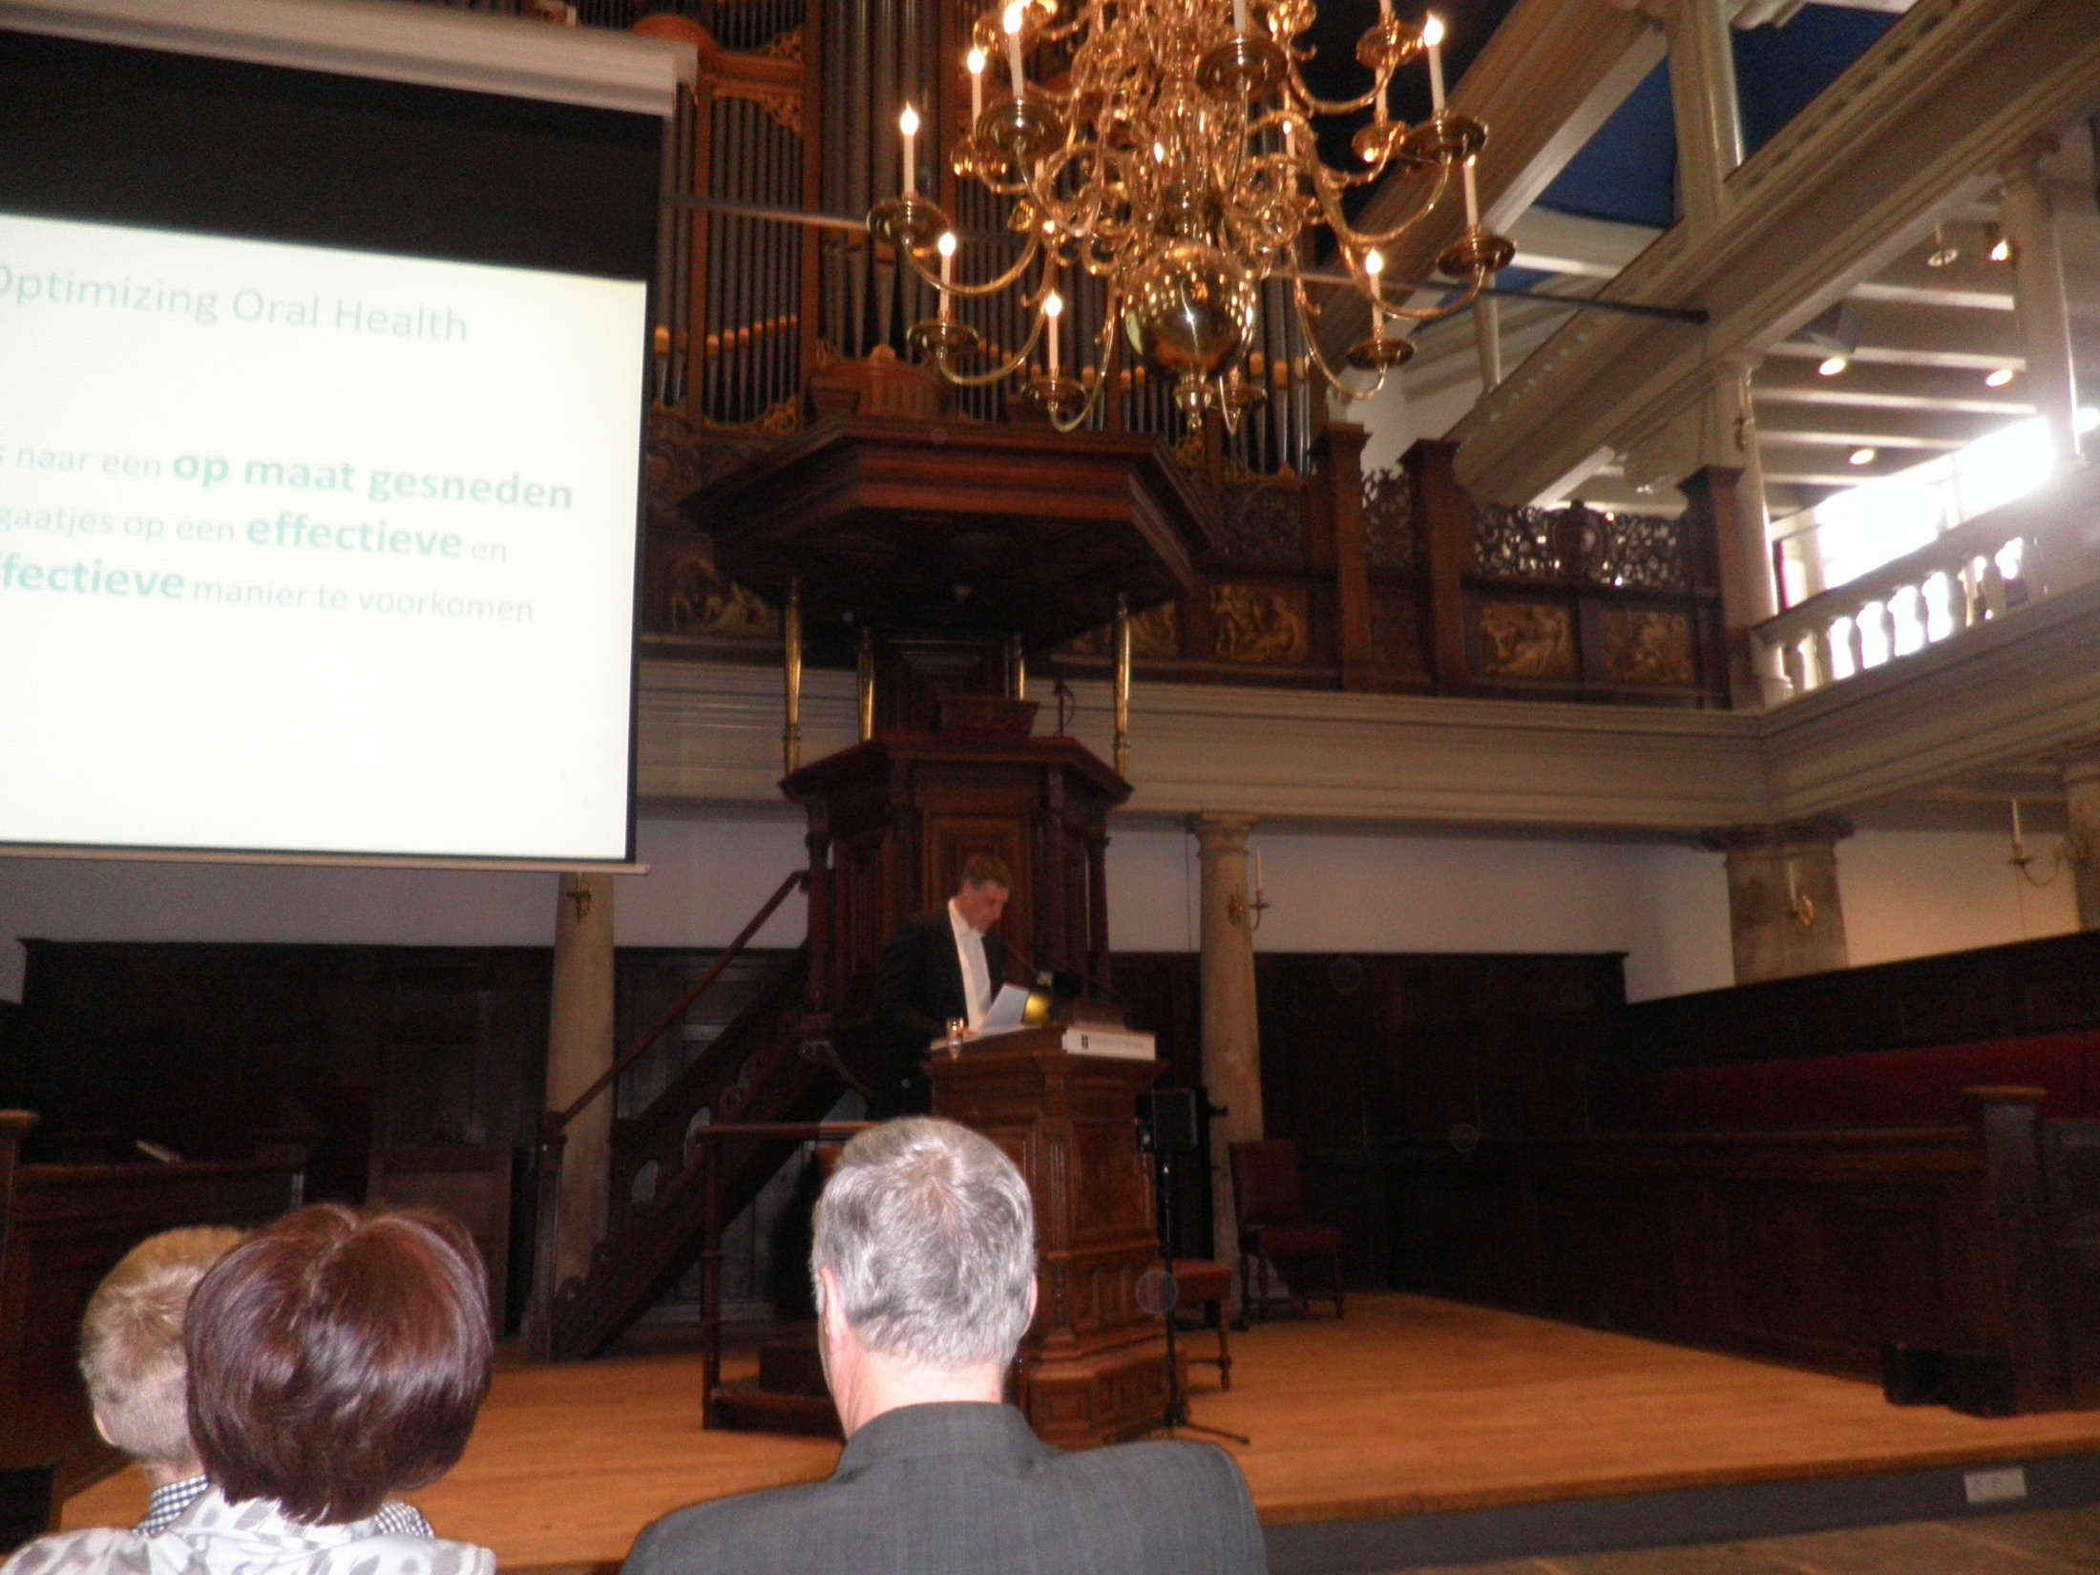
2013
Aula van de Universiteit van Amsterdam
Erik Vermaire PhD defense: Optimizing Oral Health
Towards a tailored, effective dental care

Slide 50

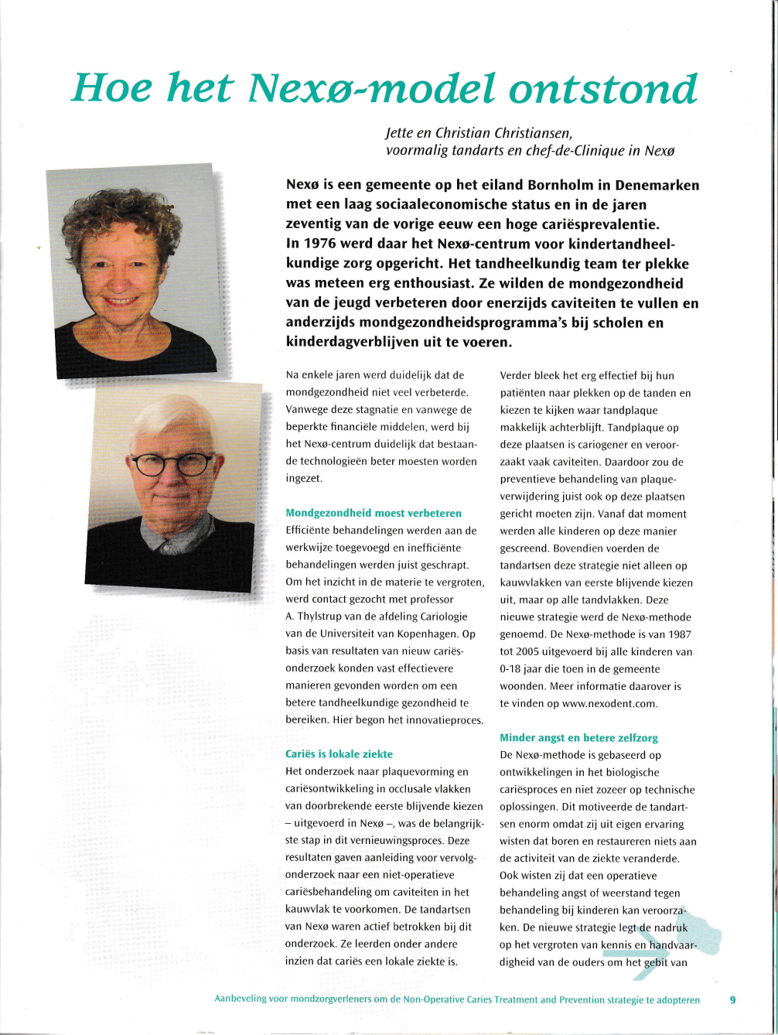
2013
Aanbevling voor mondzorgverleners om de Non-Operative Caries Treatment and Prevention strategie to adopteren

Slide 51

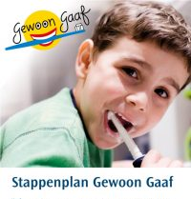
2014

Slide 52
2014
Healthy teeth: All on board
Ashley Verlinden, Annemarie Schuller, Erik Vermaire
“GigaGaaf”
Long-term effects of a community-based oral health intervention for young children in the Netherlands: A 5-year follow-up
D.A.Verlinden, A.A.Schuller, J.H.Vermaire, S.A.Reijneveld. Community Dent Oral Epidemiol. 2023;00:1-9

Slide 53
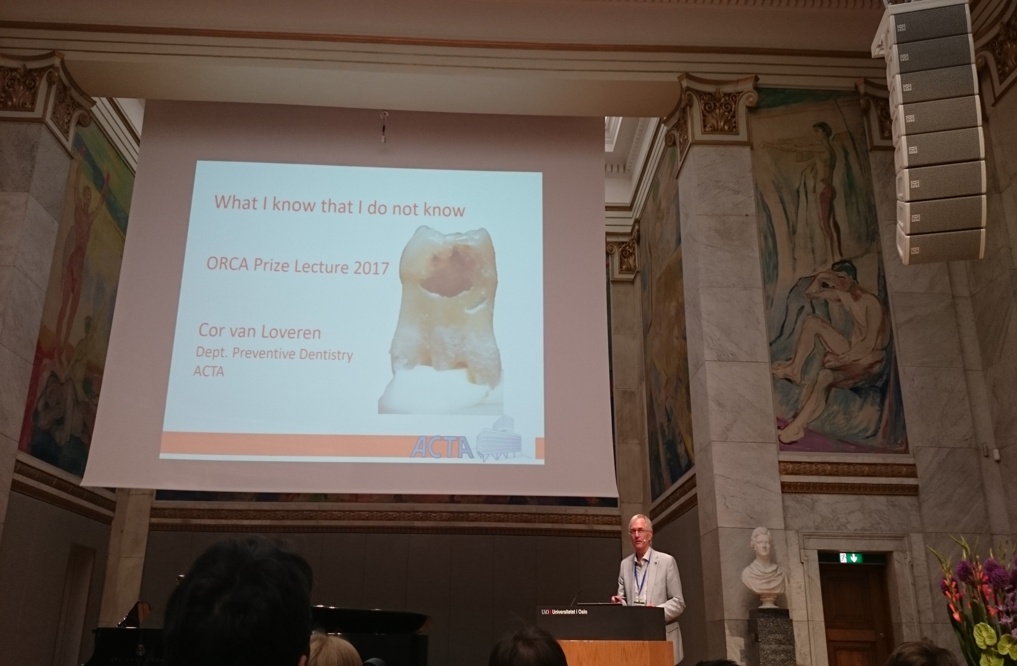
ORCA 2017 Norway Oslo

Slide 54
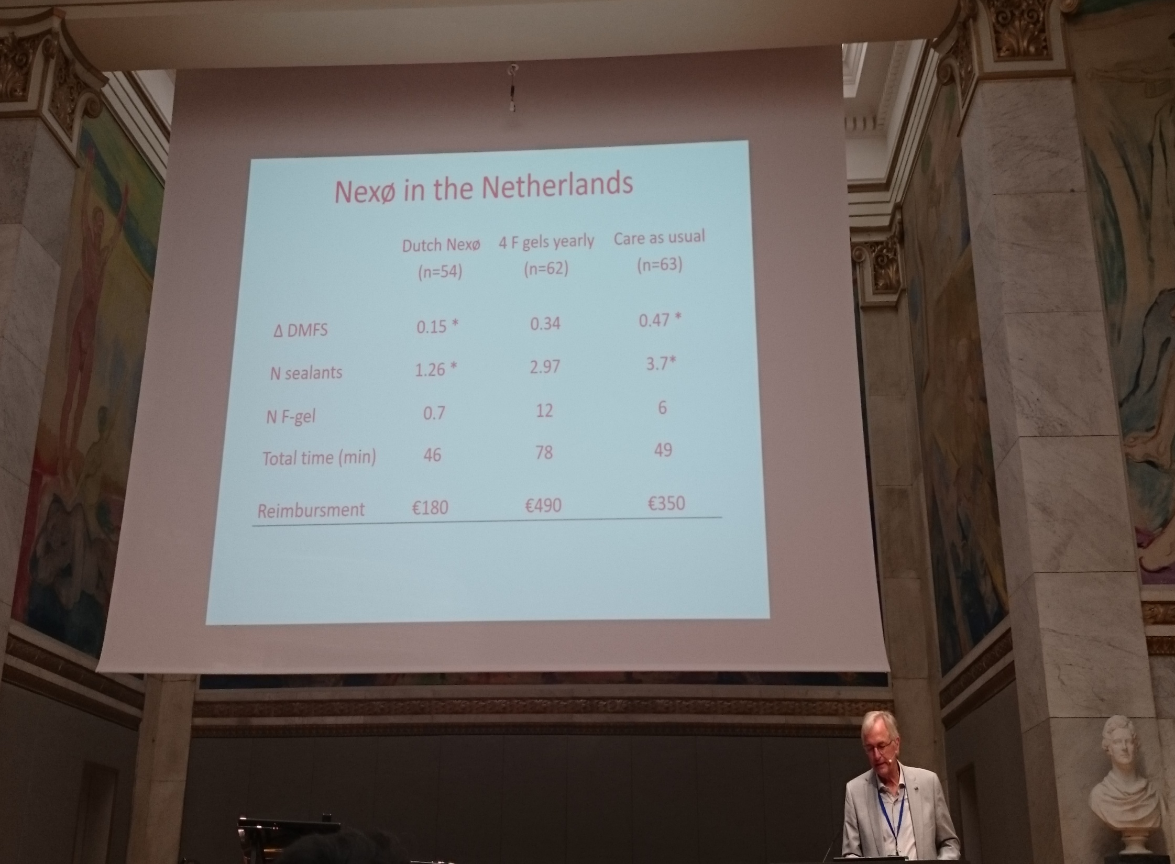
ORCA 2017 Norway Oslo

Slide 55
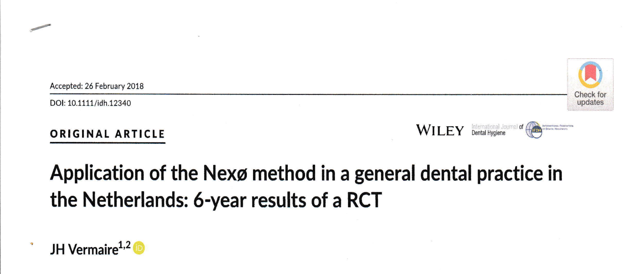
2018

Slide 56
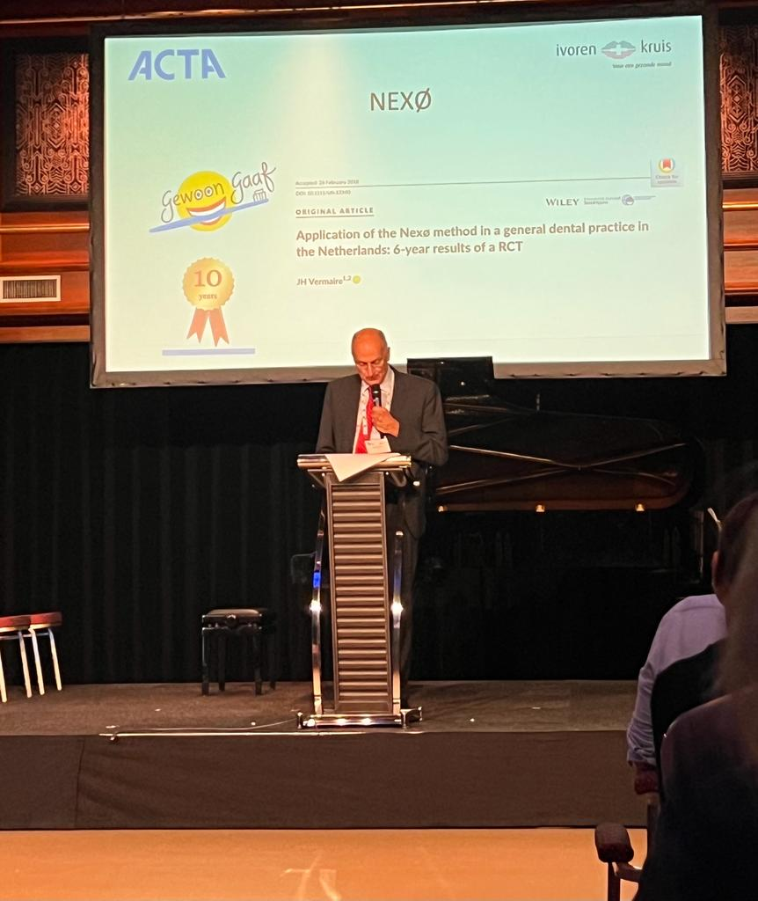
ORCA 2023 The Netherlands Egmond ann Zee

Slide 57
Ivoren Kruis 10 jaar
Gewoon Gaaf
Nexø in the Netherlands
Stappenplan Ivoren Kruis
NOCTP Recommendation
Testing the Nexø Method PhD
NVvK & VBTGG congress
NVM conference
Groningen visit to Nexø
NVT congress
ACTA visit to Nexø
ORCA
1995 2001 2005 2008 2013/14 2024

Slide 58

Congratulations

Slide 59
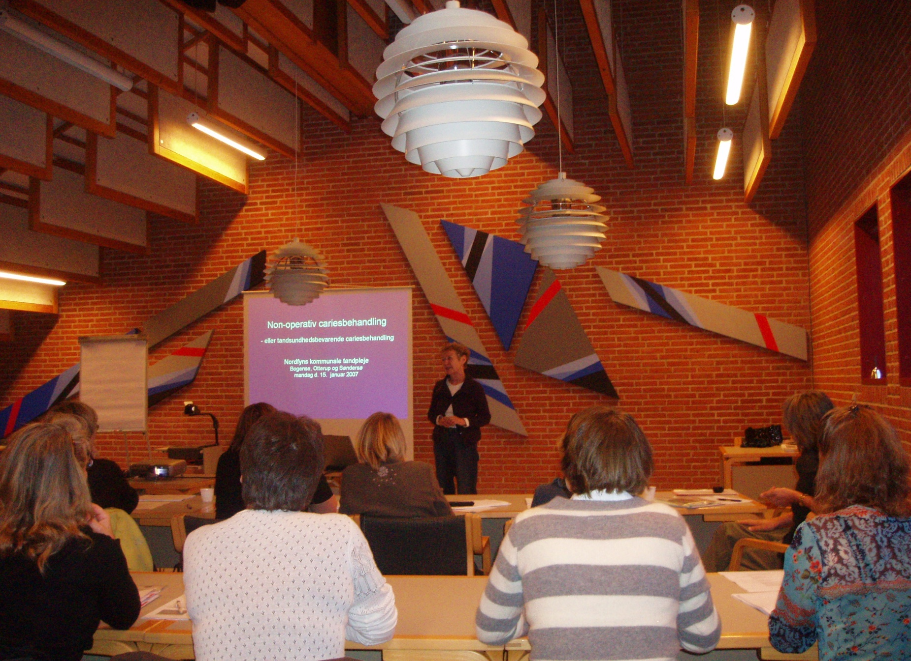
Denmark today
Funen 2007

Slide 60
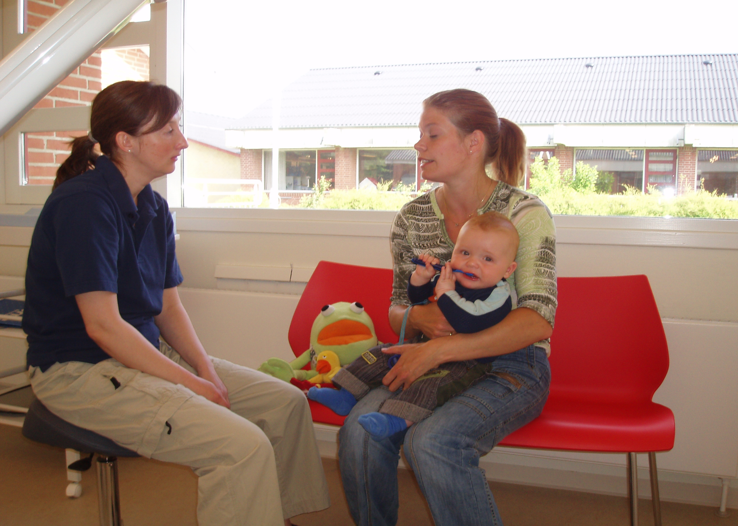
Dental hygienist
Kibæk, Jutland 2006

Slide 61
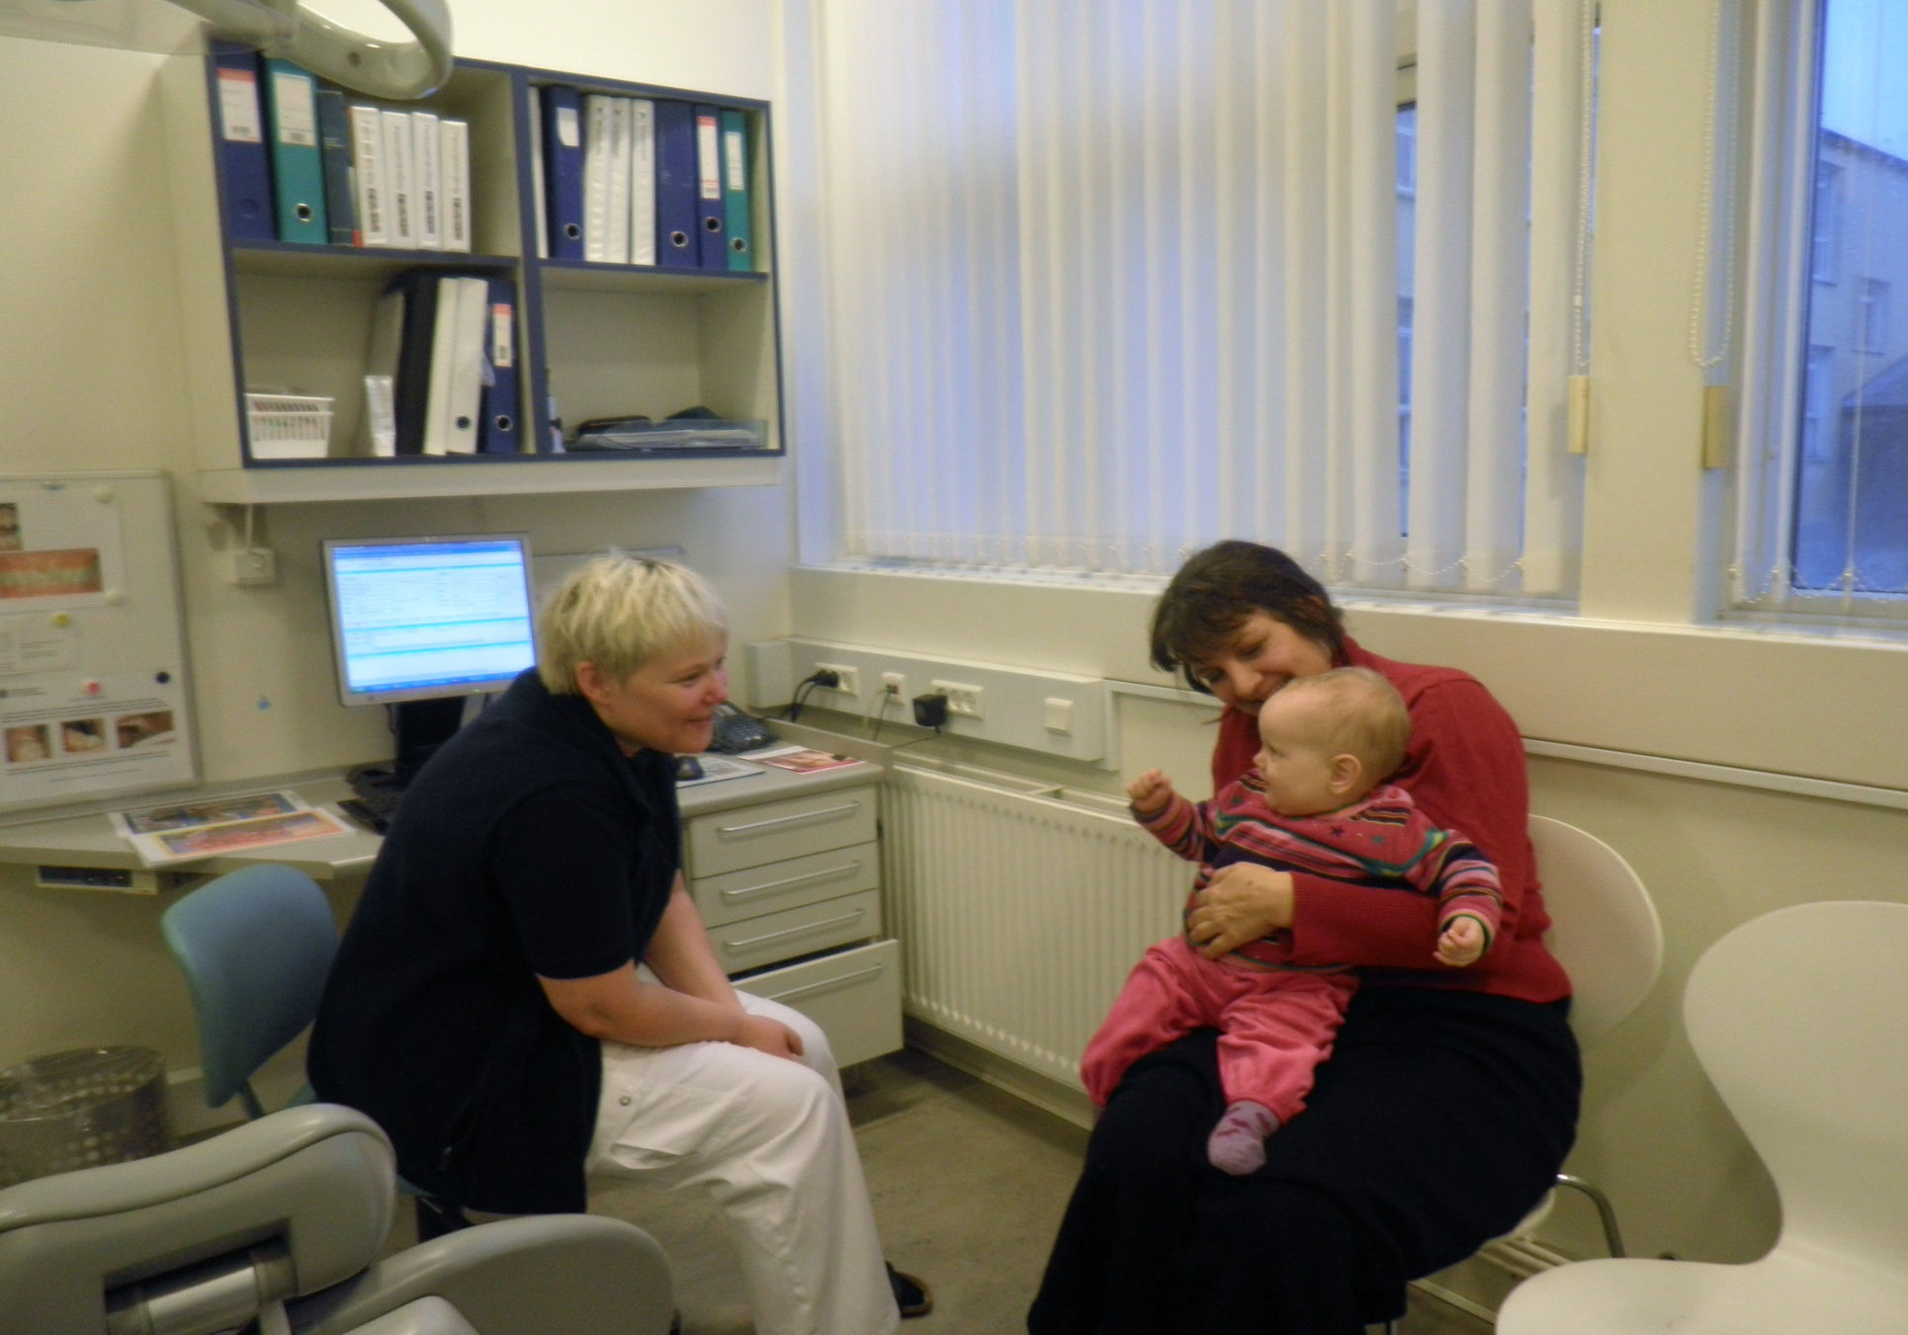
Dental assistant
Copenhagen 2014

Slide 62
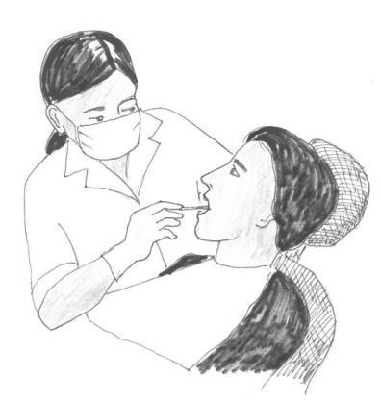
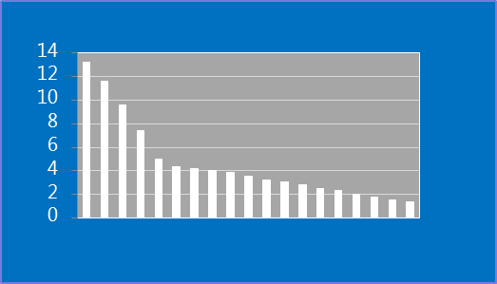
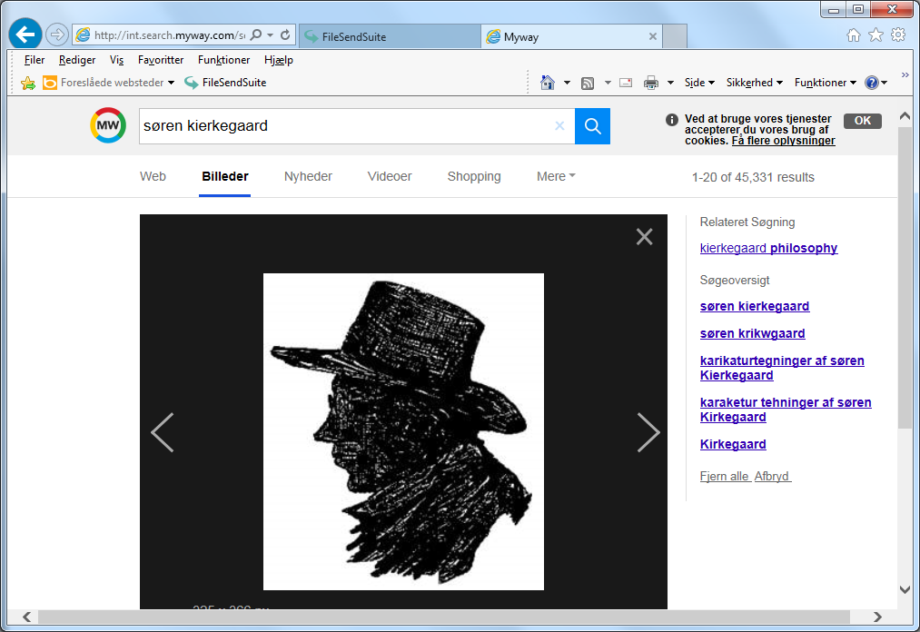

ORCA 2018 Denmark Copenhagen
DMF-S (15 yrs old)
+
+
=
1981
2017
” If One Is Truly to Succeed in Leading a Person to a Specific Place,
One Must First and Foremost Take Care to Find Him
Where He Is and Begin There”
S. Kierkegaard
Back of the ORCA program
Introduction lecture by Jette Christiansen

Slide 64
ORCA 2023 The Netherlands Egmond ann Zee
Denmark: Primary dentition 1972 -2022
Longitudinal course from 3 to 5 to 7 years
defs/DMFS improvements in the Public Dental Health Service for Children/Adolescents in Denmark during 1972-2022
J. Christiansen, M.E.C. Christiansen, K.R. Ekstrand
Section for Cariology and Endodontics, Department of Odontology, University of Copenhagen

Slide 65
Denmark today
Good News and Problems:
Act on oral health care: 0 - 18yrs
Closing of small schoolclinics = centralization
Lack of dentists/ hygenists /dental assistants
Insufficient resources
-21yrs

Slide 66
Denmark today
Structure Process Result
+ =
Central clinics
Lack of staff
Insufficient resources
Extended recall intervals
2023: No improvements
Quality assurance in dental health care
Donabedian A.

Slide 67
The Netherlands today
Structure Process Result
Quality assurance in dental health care
Donabedian A.

Slide 68


“Ik wil cariës de wereld uit helpen”
Interview Dental Tribune April 2023
Result
Good luck
Thank you for your attention
Structure
NOCTP
.

